Slide 1


DHC in Europe: a roadmap to decarbonisation
By Crélida Mata
PROFESSIONAL & SCIENTIFIC CONFERENCE TOPS 2024
10 June 2024

Slide 2





Euroheat & Power
Who we are:
International association for sustainable
district heating and cooling
Voice and forum of the sector
Research & Innovation platform (DHC+) involved in 17 active European projects
150+ members from more than 30 countries
National DHC associations, utilities, manufacturers, equipment suppliers, start-ups, universities, research institutes and consultancies
The Heating & Cooling Network

Slide 3



















































































































































The Heating & Cooling Network

Slide 4



Most comprehensive report on DHC
The Heating & Cooling Network

Slide 5
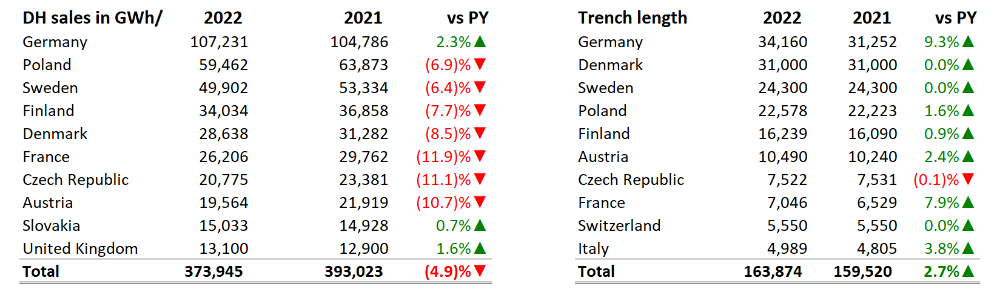
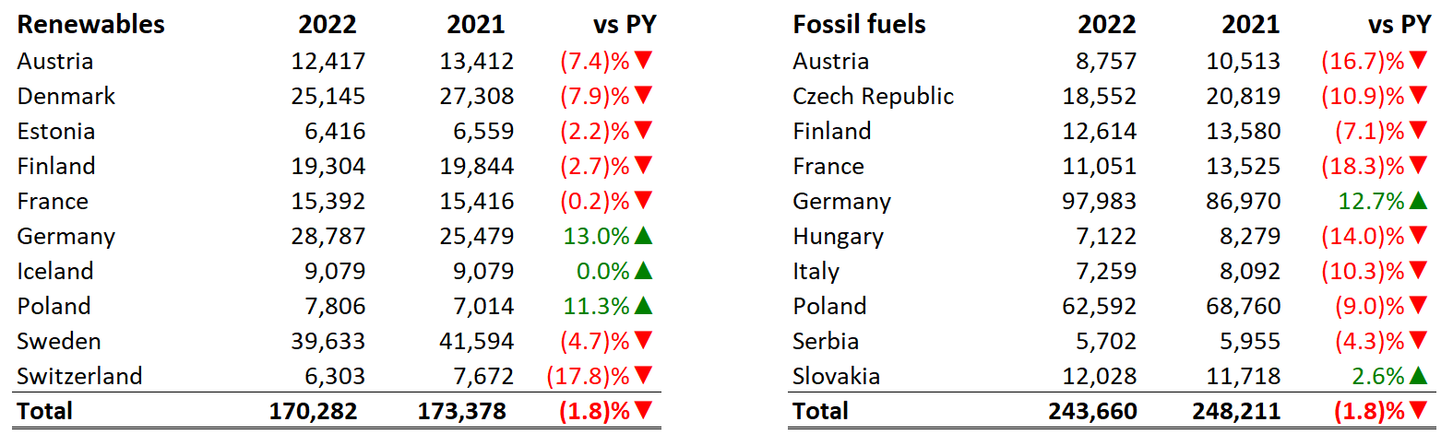
Key Figures
Notes:
DH supplied 600 TWh of heat sales decreased because of a milder winter, warmer weather in general but also - measures taken to reduce consumption. The strong 'price signal' led consumers to pay attention to energy consumption. Nevertheless, this trend was countered with connection of new customers: + 5.5% on largest markets, over 77 million citizens connected across Europe.
This figure reflects better data for some countries, as well as an enlarged scope of our work – for instance, this year we included the 500 million British citizens served by DH, 190 000 km of distribution pipes, with some increases on key markets in particular France and Germany.
There are 19,000 networks across Europe, a figure which indicates better data for some markets and growth on many others:
Spain reported 22 new networks,
France, 48,
Germany, 396,
Denmark, 1and,
Sweden 10 to give you some examples.

Slide 6
DHC Market Outlook 2024: Trends and Prospects
Reference year (2022): the energy crisis year
DH proved resilient in a difficult situation,
with short-term priorities to ensure security of supply and deal with increasing fuel prices
Share of renewable sources: 39% (+0.2% y-t-y)
Share of renewable and waste heat (industry, flue gas): 42.6%
New RES projects announced recently to materialize later in data
Notes:
So, how green and sustainable DH really is?
CHP - > 2/3 of supply
Compared to the previous year, share of natural gas went down in nearly all countries – or minus 1% as of the total mix.
The share of renewables grew by 0.2% in particular biomass, geothermal and solar. Solar thermal has seen a growth of over 13% of heat supply based on this source projects starting operation mostly in DK and Poland.
Heat supplied from recovered waste heat from waste-to-energy increased from 6.1 to 6.4% supplying a little over 30,000 GWh in 2022.
We saw relative stability for other sources.
Total share of renewables is 39%. However, if we take waste heat into account, the share increases to 42.6% of the mix.
The year in perspective:
Warmer weather (compared to previous year - 2021),
Efficiency measures + conservation measures had impact on heat demand,
2022 was the energy crisis year – rising prices for fuels
Although DH proved very resilient. Truth is there was an emergency to deal with rising energy prices, with security of supply.
2022-2024: RES project up; not yet in data. Comparison of same countries year-to-year: in some countries data is better with more networks covered which also has an impact on the fuel mix.

Slide 7
DHC Market Outlook 2024: Trends and Prospects
District heating: ready to grow!
Energy crisis as catalyst for new measures to launch new growth cycle for DH
Germany – BEW (€ 3bn 2022-26)
France – Heat fund (€ 850mill. in 2024)
Austria – DH decarbonisation (€ 557mill. 2023-2030)
Czech Republic – modernisation fund (€1.2bn 2022-2026)
15 Member States calling for acceleration of heat transition with more district heating (May 2024)
Based on government objectives and forecast by associations: + 8 million households connected by 2030
Notes:
DHC decarbonisation roadmaps
Increasing role of waste heat, new urban heat sources, geothermal and solar heat.
large heat pumps are to play central role to valorise strategic heat sources.
renewed interest in Geothermal, with initiatives across Europe, a project started operation recently in Hungary, there has been also many projects with shallow geothermal
solar is also expected to grow in suitable locations and is an excellent solution to diversify complement the fuel mix.
A recent Aalborg study foresaw 20 TWh solar in DH by 2030.
On Waste heat, all countries plan to increase its share: in Germany alone the Prognos study forecasts 11 TWh of waste heat recovered in DH system by 2030.
We see in Finland, Denmark Sweden rising interest with sector coupling and projects related to data centres or hydrogen.
The wave of investments we have seen recently is projected to continue; they indicate the trajectory for years to come.

Slide 8



What now?
DHC+
The Heating & Cooling Network
The Heating & Cooling Network

Slide 9




Heating and cooling decarbonisation needed to be on track for 2040
  42% EU energy demand
  35% energy-related GHG emissions
  80% energy demand for heating & cooling
  75% coming from fossil fuels
What are the sectors with highest untapped CO₂ abatement potential?
Reduce GHG emissions by 90% in 2040, compared to 1990 levels
Buildings
  25,6% EU energy demand
  60% energy demand for heating & cooling
Industry
The Heating & Cooling Network

Slide 10
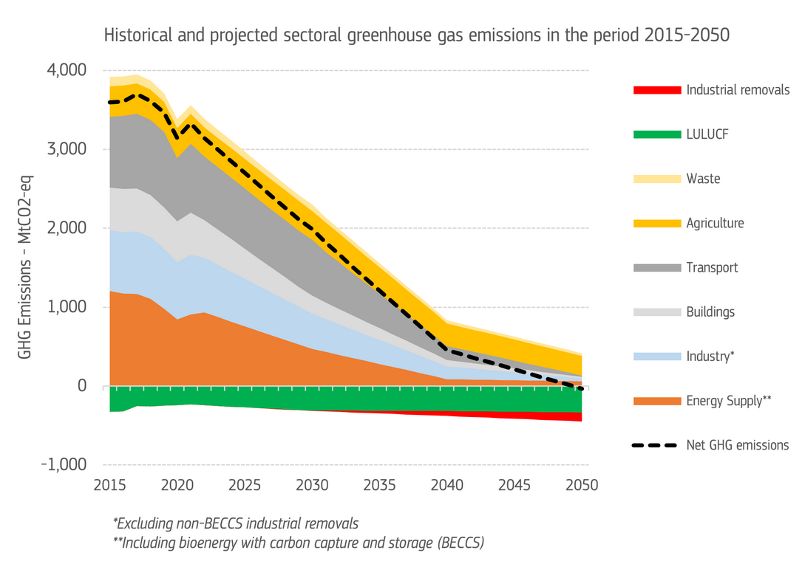
The decarbonisation curve in coming years will be quite steep
55%
90%
The Heating & Cooling Network

Slide 11
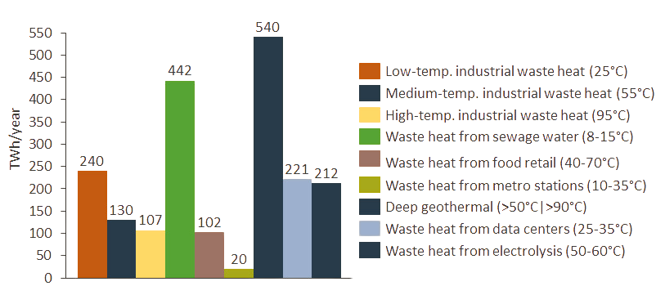
Let’s not waste abundant RES and climate-neutral heat sources !
More than 2000Twh/year of renewable and climate-neutral heat sources are available in Europe.
More than the EU’s total forecasted heat demand by 2050 (1850 TWh/y) !
  Potential for new heat sources 2050 - source: Aalborg university
Diversification
Circularity
Peak shaving
Just transition
The Heating & Cooling Network
Notes:
District heating and cooling networks are the only energy infrastructure enabling the utilisation of waste heat, hence we call for the support of DHC network developments.
Enable local heating and cooling plans with a public registry of decarbonised heat sources.
Identify best practices for business models derived from real projects, spread know-how and good practices, facilitate communication and provide training to stakeholders.
Require the mandatory development of de-risking instruments for clean heat projects and create incentives for sector integration.
Encourage the building of new data centres in areas with available DHC network nearby.
Data centres are located in most major cities and can provide buildings with local sustainable heat via DHC networks. This has been operational and a reality in EU cities for years.
Waste heat represents 3.6% of total district heat deliveries for 2022, including the share of heat recovered from the industrial and service sectors and flue-gas condensing. This share is highly conservative, as some countries do not report the use of waste heat in district heating.
The share of heat recovered from non-biodegradable municipal wastes in waste-to-energy plants represents 6.4% of the total fuel mix. The highest shares of waste heat are found in markets where district heating is well established, and where both heat planning and/or taxation schemes provide a favourable context for these projects.
There is a vast untapped potential for waste heat in Europe. A recent paper21 found waste heat from power generation, industrial and waste-to-energy installations amount to 2,860 TWh/y in the EU, almost equivalent to the region’s total energy demand for space and water heating in residential and service buildings.
Data centres are a promising new source of waste heat for district heating. Many projects have materialised over the last five years across Europe.

Slide 12
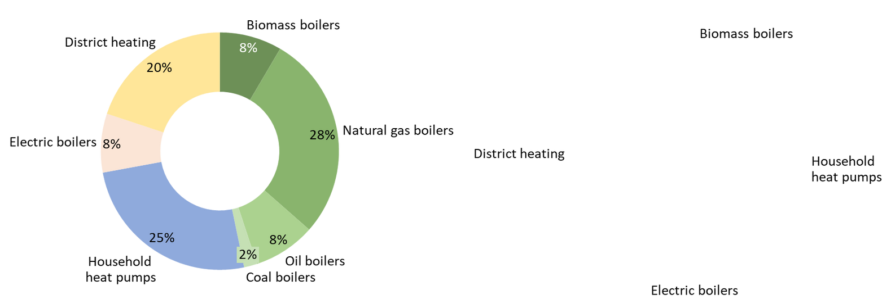
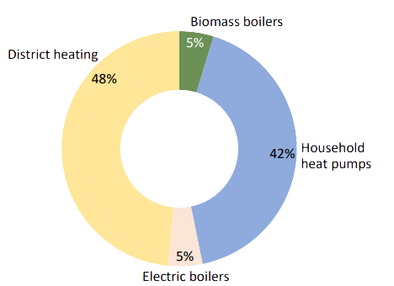
A paradigm shift is needed
to support clean heating and cooling
The European Heat Market
What is means for the DHC sector
  To be on track, we should aim at a market share of 20% in 2030 (vs. 13% today) and 10%, heat-demand reductions,
  3500 new DHC networks by 2030: an estimated 144bn EUR in investments,
  Renovation and expansion of 190.000 km of DHC pipes (upgrade + new connections)
2030
2050
Source: Heat matters: the missing link in REPowerEU, Aalborg University 2023
DHC+
The Heating & Cooling Network

Slide 13




Heating & cooling networks harness
local renewable and clean heat resources
Risk-mitigation frameworks for renewables & waste heat
Waste heat recognition: incl.
in sectoral RE targets, coordination framework to foster recovery
Gradual phase-in renewables and Waste heat with a new definition of efficient DHC
Mandatory local heating & cooling planning
For municipalities
> 45.000 citizens
Mandatory heat recovery for data centres above 1MW
"Carbon tax" on all fossil fuels used in buildings (ETS2)
Phase-out subsidies for standalone fossil-fuel boilers in buildings
District approach
to building decarbonisation (ZEB)
Notes:
New sectoral targets for renewables & waste heat in buildings, industry, heating and cooling and DHC
A new definition of “efficient District and cooling networks”
With a fossil-free target by 2050 with a gradual increase of renewables and waste heat
Coordination framework between actors to foster recovery
Mandatory waste heat recovery for data centres above 1MW
EU Member States to develop risk-mitigation frameworks for renewables & waste heat
Municipal heating and cooling planning for cities above 45.000 inhabitants.
The objectives are clear but, how do we achieve them?

Slide 14
Renewable Energy Directive (REDIII)
Waste Heat must be included in sectoral targets
Sector | Renewables target | Nature of the target | Waste heat
Heating and Cooling | 0.8% (2021-2025) 1.1% (2026-2030) | Binding | Waste heat and cold can contribute up to 0.4 pp to these annual increases. If they decide to do so, the target shall increase by half of the WH percentage points counted to an upper limit of 1,0 percentage points for the period 2021 to 2025 and of 1,3 percentage points for the period 2026 to 2030.
DHC | 2.2% | Indicative | Both waste heat and cold and renewable energy sources can contribute to the target
Buildings | 49 %by 2030 | Indicative | Up to a limit of 20%. If they decide to do so, the target shall increase by half of the percentage of waste heat and cold counted towards that share.
Industry | 1.6% | Indicative | Waste heat can count towards the target, up to a limit of 0,4 pp. If they decide to do so, the average annual increase shall increase by half of the waste heat and cold percentage points counted.
As Member States will have to count WH under several articles, the European Commission is preparing a guidance document to be released after the summer.
The Heating & Cooling Network
Notes:
To succeed, the European buildings and DHC sector must embark on a deep transformation, which will require major investment and appropriate regulatory frameworks at national and EU level. The success of this transformation relies on the four key pillars:
Making EU buildings “low-temperature ready” and DHC compatible,
Boosting the use of clean and renewable heat sources in buildings,
Supporting the buildout, modernisation and expansion of DHC infrastructures,
Unlocking the sector’s contribution to system balancing and demand response.
Our recommendations are:
Apply a district approach to building renovations and energy performance assessments,
Deliver a meaningful carbon price for heat used in buildings,
Adopt a zonal repartition of clean heat incentives for consumers, in line with the results of local heating and cooling plans,
Require the mandatory development of de-risking instruments for clean and renewable heat projects,
Establish aggregated financing instruments for clean heat, from impact assessment to project delivery,
Simplify and accelerate state aid procedures for clean heat projects,
Unlock synergies between electricity and thermal infrastructures,
Develop a robust, comprehensive 2040 framework

Slide 15
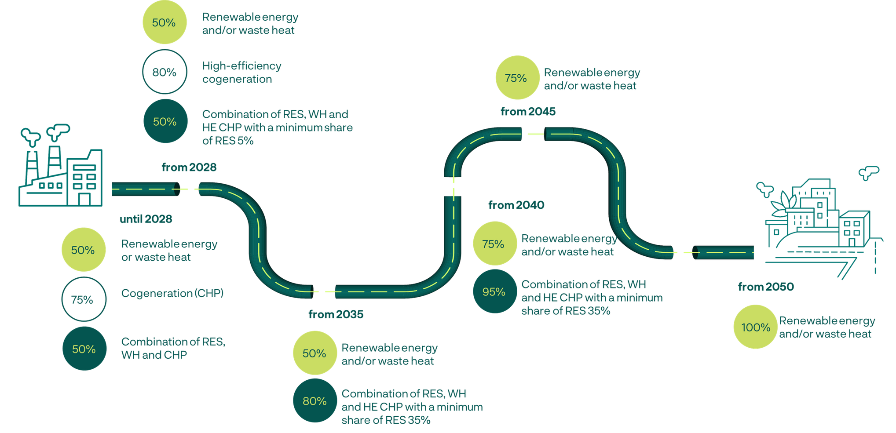
Energy Efficiency Directive (EED)
The Energy Efficiency Directive introduced a new definition of Efficient DHC networks (with 2 options).
Default option: includes milestones to get to net zero by 2050.
When building or substantially refurbishing DHC:
No increase in the use of fossil fuels other than natural gas
No new fossil fuels capacity from 2030
Consequence of definition:
Not binding but connected to other legislation (e.g. EPBD)
Conditions funding
Systems not meeting def. shall prepare a plan
The Heating & Cooling Network
Notes:
Heating and cooling supply:
1. to ensure more efficient consumption of primary energy and to increase the share of renewable energy in
heating and cooling supply going into the network, an efficient district heating and cooling system shall meet the
following criteria:
(a) until 31 December 2027, a system using at least 50 % renewable energy, 50 % waste heat, 75 % cogenerated heat or
50 % of a combination of such energy and heat;
(b) from 1 January 2028, a system using at least 50 % renewable energy, 50 % waste heat, 50 % renewable energy and
waste heat, 80 % of high-efficiency cogenerated heat or at least a combination of such thermal energy going into the
network where the share of renewable energy is at least 5 % and the total share of renewable energy, waste heat or
high-efficiency cogenerated heat is at least 50 %;
(c) from 1 January 2035, a system using at least 50 % renewable energy, 50 % waste heat or 50 % renewable energy and
waste heat, or a system where the total share of renewable energy, waste heat or high-efficiency cogenerated heat is at
least 80 % and in addition the total share of renewable energy or waste heat is at least 35 %;
(d) from 1 January 2040, a system using at least 75 % renewable energy, 75 % waste heat or 75 % renewable energy and
waste heat, or a system using at least 95 % renewable energy, waste heat and high-efficiency cogenerated heat and in
addition the total share of renewable energy or waste heat is at least 35 %;
(e) from 1 January 2045, a system using at least 75 % renewable energy, 75 % waste heat or 75 % renewable energy and
waste heat;
(f) from 1 January 2050, a system using only renewable energy, only waste heat, or only a combination of renewable
energy and waste heat.
2. Member States may also choose, as an alternative to the criteria set out in paragraph 1 of this Article, sustainability
performance criteria based on the amount of GHG emissions from the district heating and cooling system per unit of heat
or cold delivered to the customers, taking into consideration measures implemented to fulfil the obligation pursuant to
Article 24(4) of Directive (EU) 2018/2001. When choosing those criteria, an efficient district heating and cooling system
shall have the following maximum amount of GHG emissions per unit of heat or cold delivered to the customers:
(a) until 31 December 2025: 200 grams/kWh;
(b) from 1 January 2026: 150 grams/kWh;
(c) from 1 January 2035: 100 grams/kWh;
(d) from 1 January 2045: 50 grams/kWh;
(e) from 1 January 2050: 0 grams/kWh
A gradual transition to a 100% green supply

Slide 16




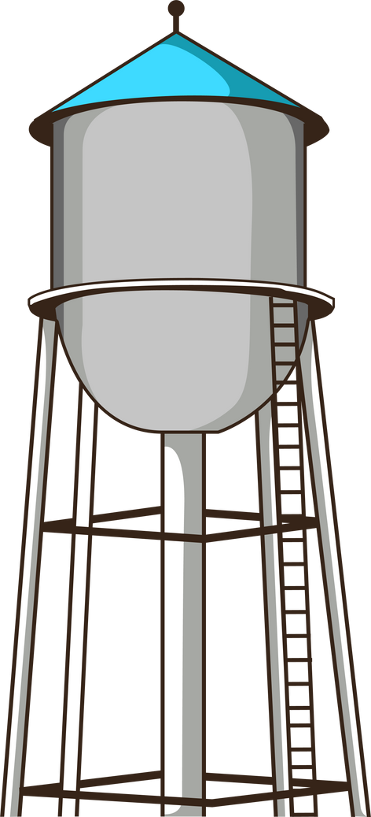


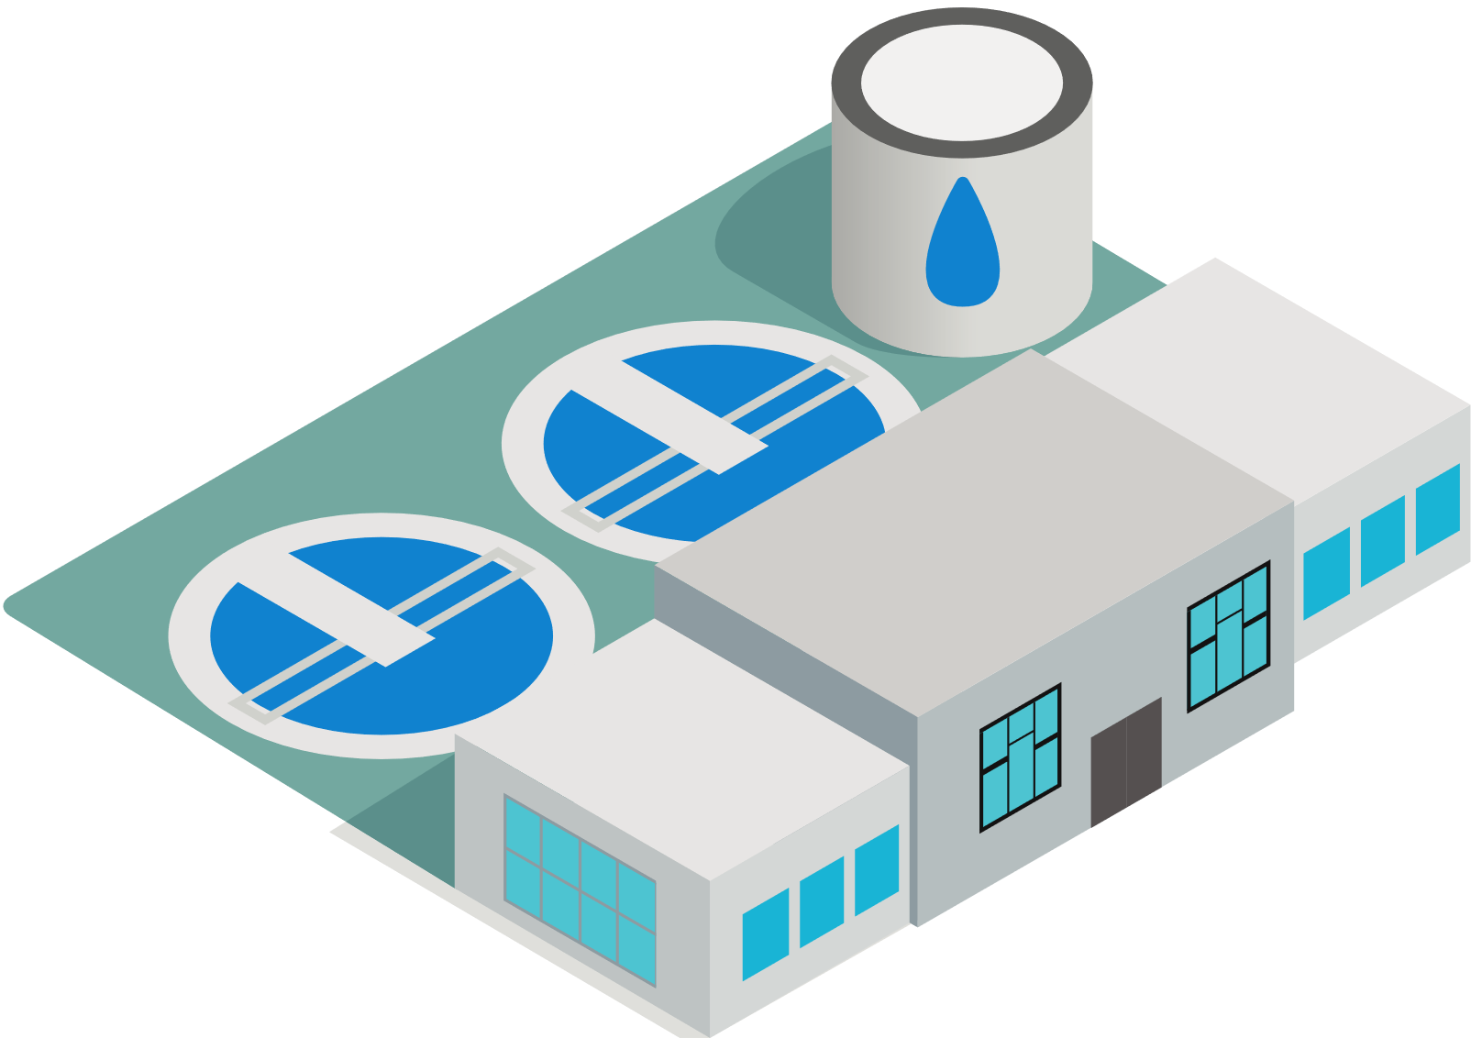




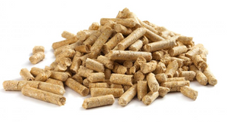






A strategic approach to the EU heat transition
Waste management
Grids
Storage
Excess heat: tertiary &
public buildings (hospitals, industries, stores, sewage water facilities)
Grid and flexibility Infrastructures
Deep renovations
Phase out fossil boilers
ZEB criteria
RES Heat sources
A variety of sustainable, local heat and energy sources
Which can be harvested and optimised depending on local buildings characteristics
RES Electricity
1) Heat plans identify locally available clean resources and infrastructures
2) What is the most climate-efficient solution? for which consumers, and where?
The Heating & Cooling Network
The Heating & Cooling Network
Notes:
Following European elections in June 2024, a new EU mandate will take the driver’s seat to pursue the Green Deal agenda, and address some of the most pressing concerns brought by the recent energy crisis: competitiveness, energy security, and affordability. Heating and cooling decarbonisation is at the core of this equation.
On May 15th, 15 EU countries (Latvia, Austria, Cyprus, Denmark, Estonia, France, Ireland, Greece, Lithuania, Luxembourg, Malta, Portugal, Slovakia, Slovenia and Spain) joined forces in a non-paper calling on the European Commission to increase decarbonisation efforts in the heating and cooling sector and realise the immense potential of district energy systems to reach the EU's 2040 energy and climate ambitions.

Slide 17

It isn’t only about the notes, we need a score, a conductor
DHC+
The Heating & Cooling Network
The Heating & Cooling Network
Notes:
The decarbonisation journey is one that requires leadership and agency. All stakeholders must take responsibility. Crucially, as DHC is a local solution, local municipalities must engage with this journey, supported by the national government and the EU where applicable.

Slide 18
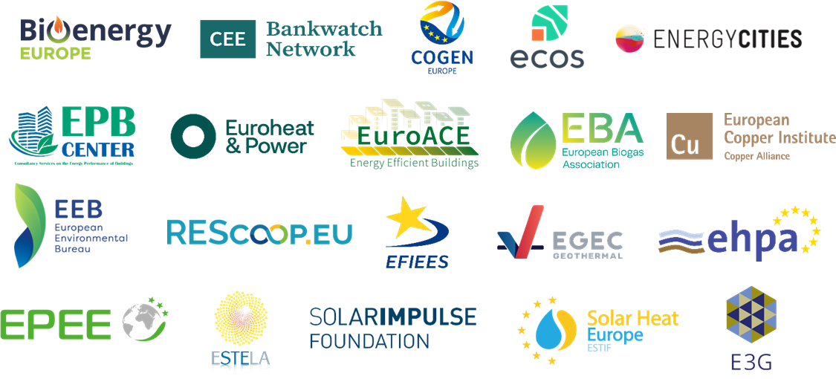
2040 Climate Target Joint Statement
20 signatories to the joint statement:
  Heating and cooling decarbonisation must happen to be on track for 2040 target.
  Clean Heat solutions are ready to deploy to phase out fossil fuels in homes and industry.
  Further targeted action is needed beyond FF55, in the post 2030 framework.
Finance energy efficiency and RES & WH projects
Integrated strategies for building renovations and heating and cooling decarbonisation
The Heating & Cooling Network

Slide 19





A European heating & cooling strategy
  Bring consistence and visibility to the EU and national heating & cooling framework
  Mandate National Heat Strategies in NECP’s, reflecting Fitfor55' provision
  Speed up heat decarbonisation with additionnal measures (funding, de-risking)
  Industrial support to scale-up EU production (heat-pumps, pipes, etc.)
No stranded clean heat sources
Smart building renovations
Heat planning act: District approach
for clean heat incentives & EPC
Heat Pump
Action Plan
Geothermal strategy
European Heat Fund
Waste heat recovery framework
Faster project completion
DHC+
The Heating & Cooling Network
The Heating & Cooling Network

Slide 20

Shedding light on the
EU heat transition
  EUSEW 2025 focus on heating and cooling decarbonisation
  European year for heating & cooling
  Dedicated EC conference on heating and cooling transition
DHC+
The Heating & Cooling Network
The Heating & Cooling Network
Notes:
I would conclude by saying that there are great ambitions fort the sector and the necessary tools to achieve them. Nonetheless, it is crucial to recognise the particular situation of individual countries. While some are well under way to achieving the goals set out, and are already using 4th and 5th generation technologies, others will require additional support in terms of investment and knowledge share to upgrade their existing systems.
The decarbonisation of the sector is needed and can be achieved. However, work still needs to be done and all stakeholder be involved.

Slide 21


THANK YOU!
Crélida Mata
Market Intelligence Analyst
cm@euroheat.org
Crélida Mata
euroheat.org
The Heating & Cooling Network

