Slide 1
INTEGRACIJA SOLAR-TERMAL POTROJENJA SA SEZONSKIM SKLADIŠTEM TOPLOTE U SISTEM DALJINSKOG GREJANJA NOVOG SADA
Stručno-naučna konferencija TOPS 2025, Zlatibor
Vladimir Munćan, Igor Mujan, Aleksandar Anđelković, Dušan Macura

Slide 2
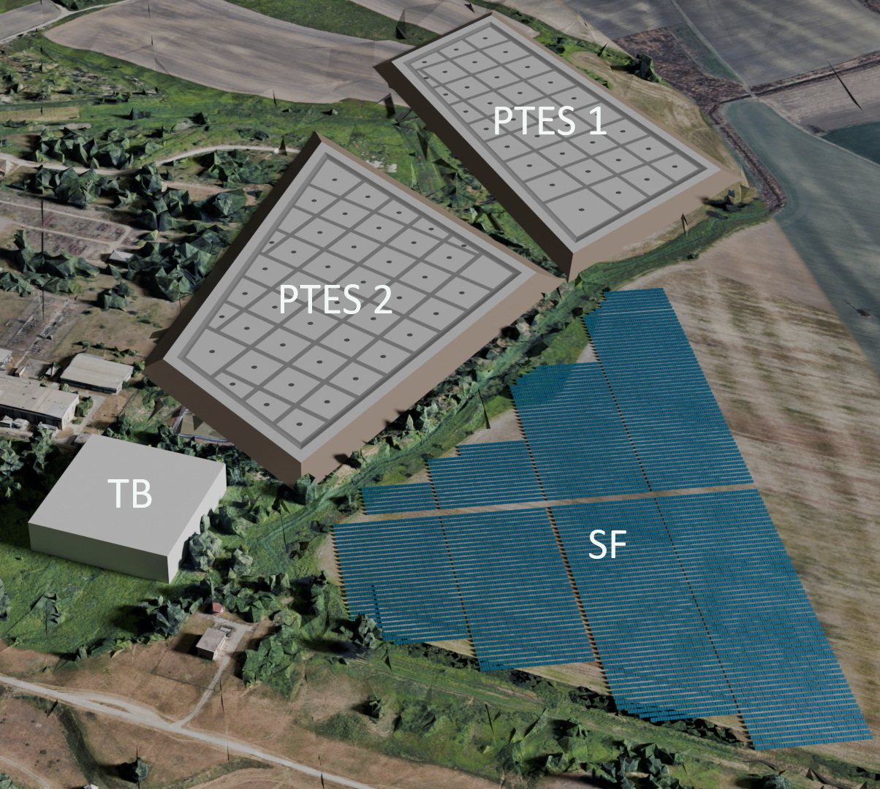
Solar-thermal novi sad: system design

Slide 4
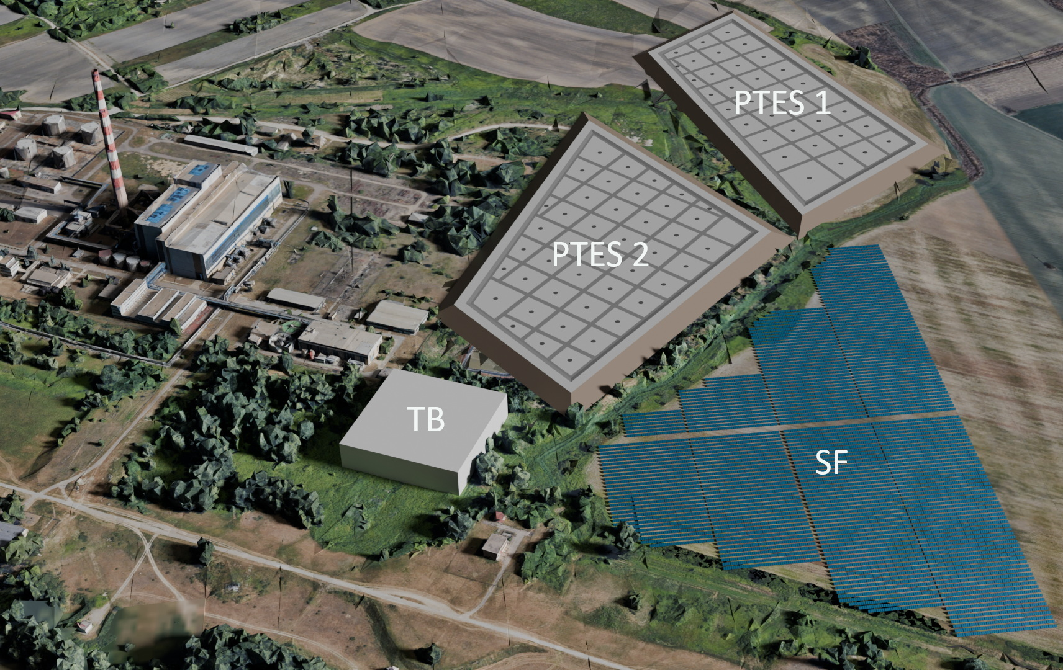
System overview

Slide 5
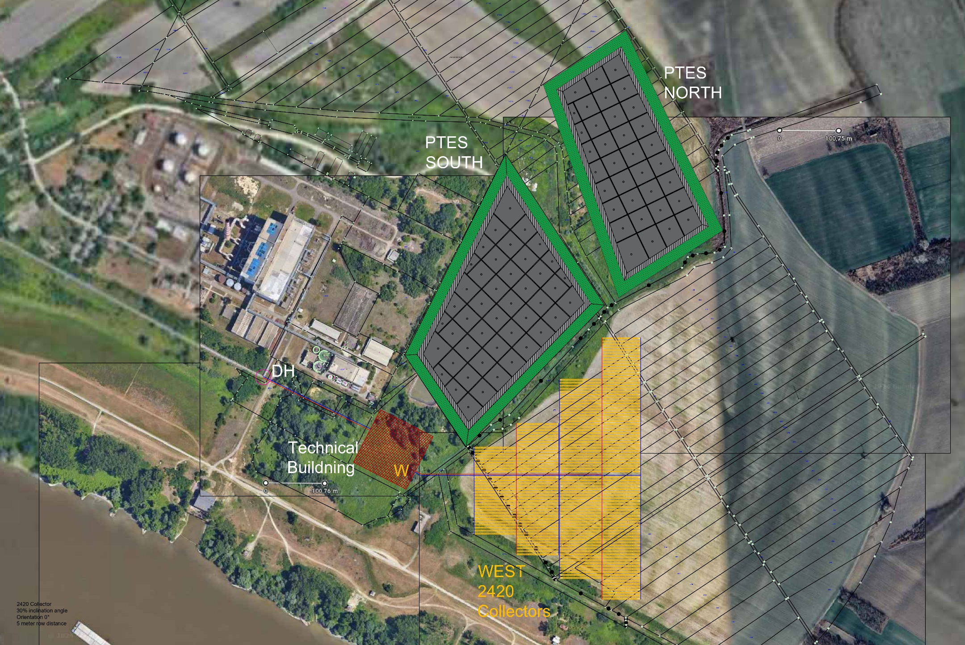
System overview

Slide 6
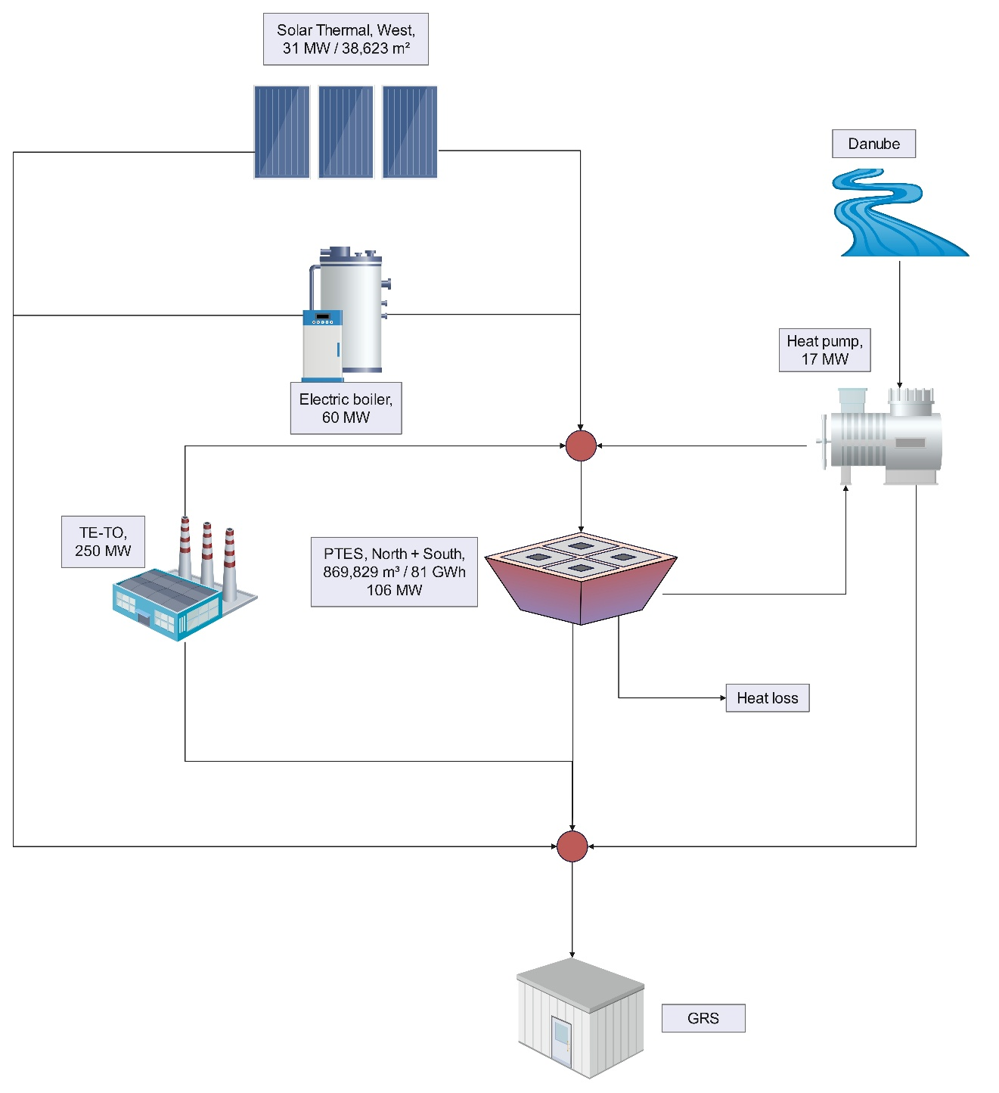
How does it work?
Main components:
Solar thermal collector field
PTES – Pit thermal energy storage
Electric Boiler - eBoiler
electrical Heat pump
Water intake from Danube river
TE-TO - Efficient CHP
DH Network pipeline
GRS – Existing District Heating System

Slide 7
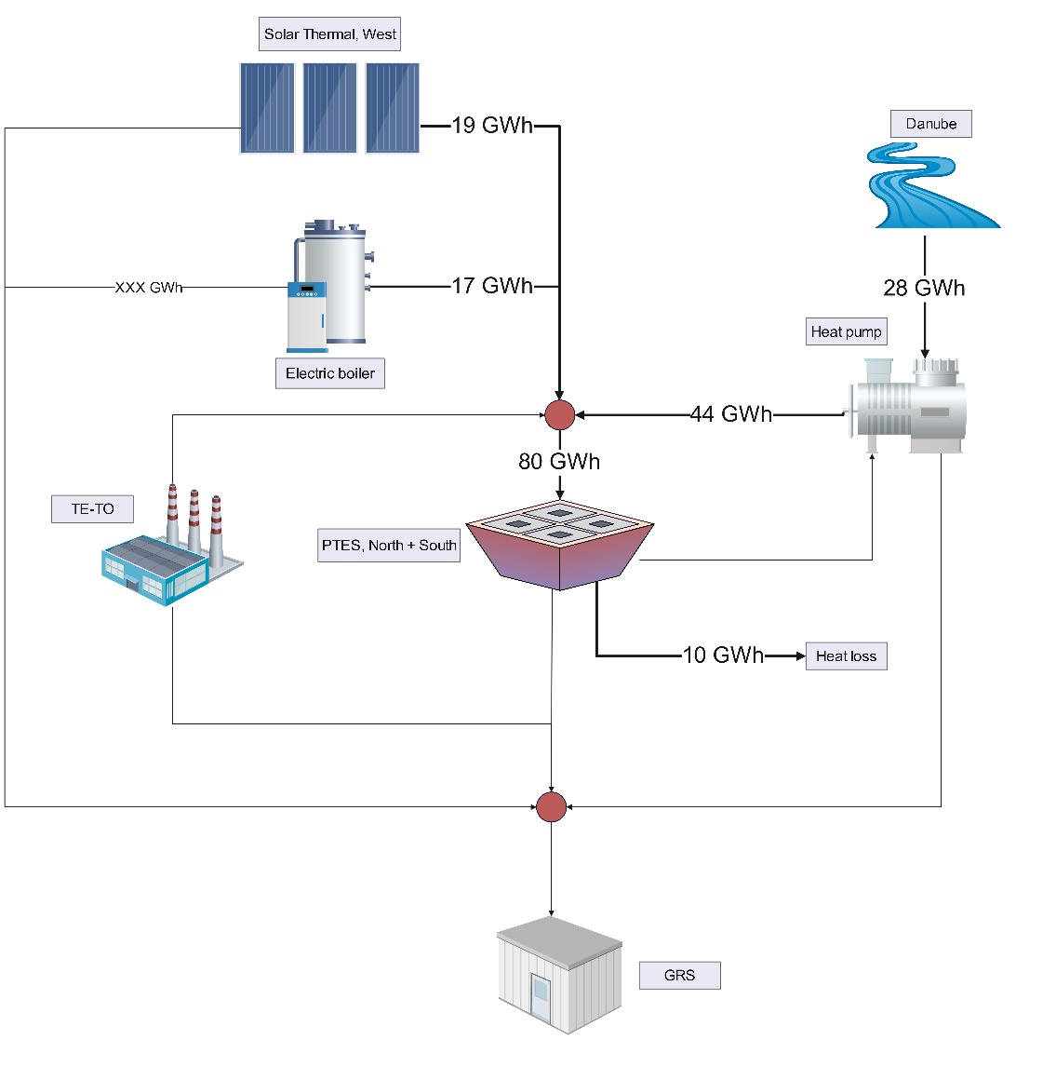
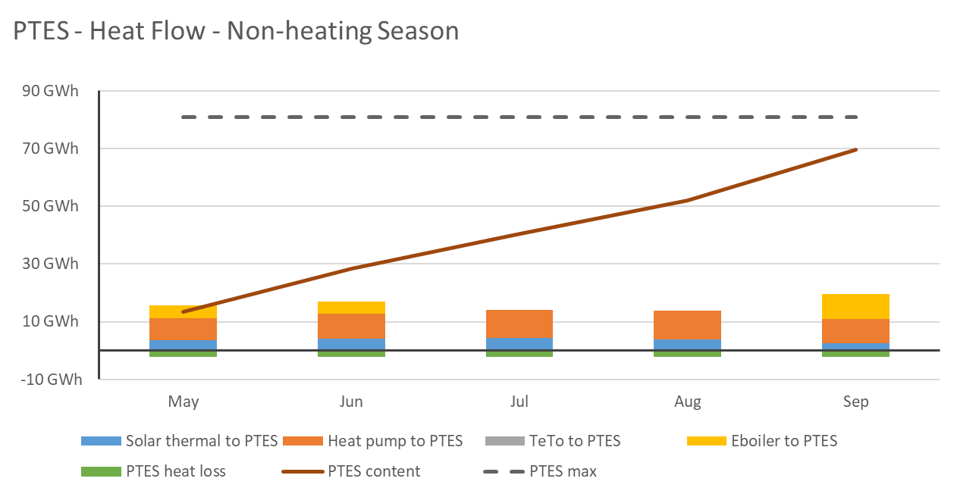
Non-heating season (CHARGING PTES)

Slide 8
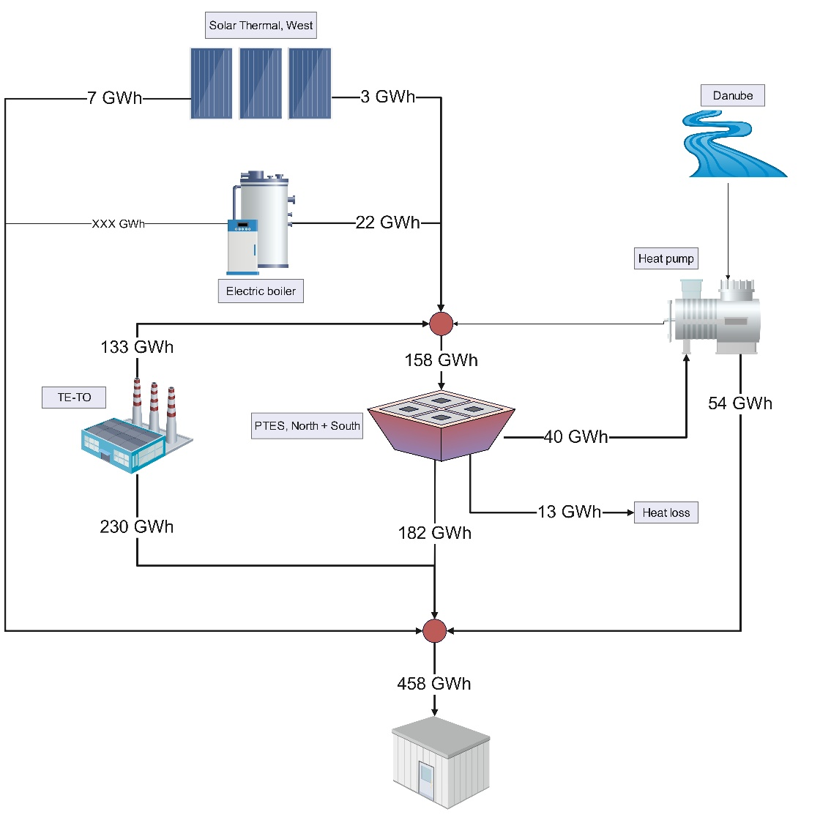
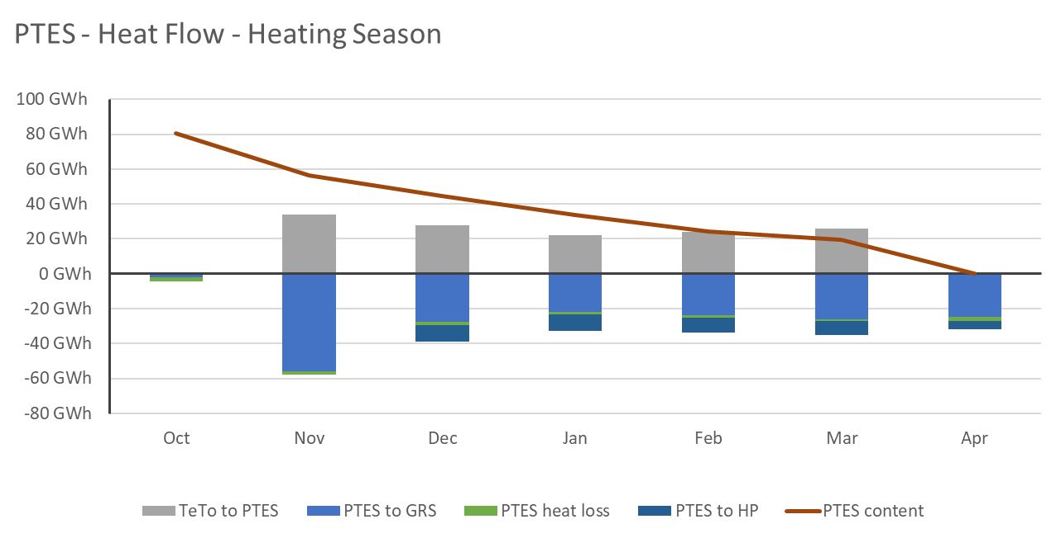
heating season

Slide 9
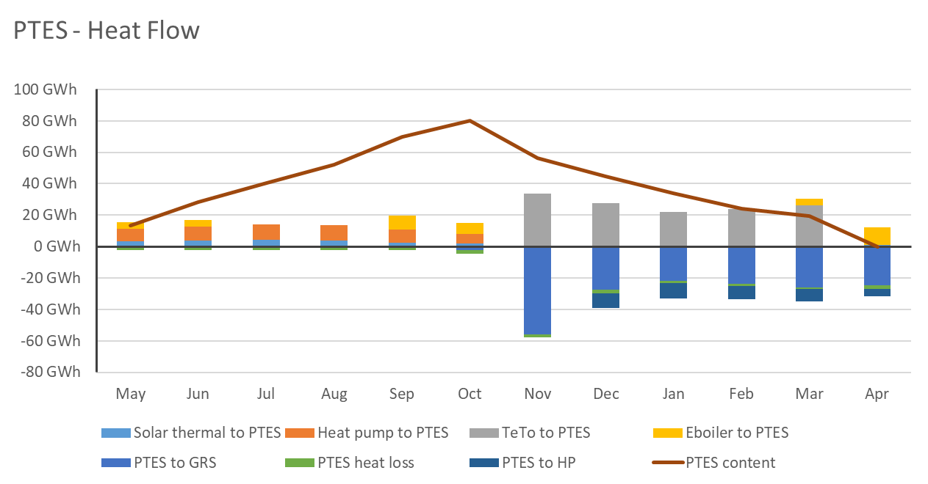
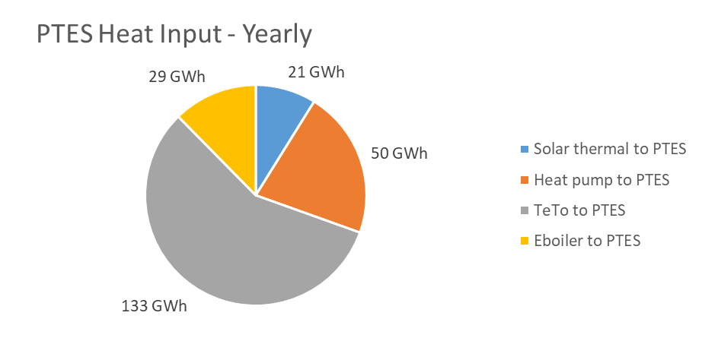
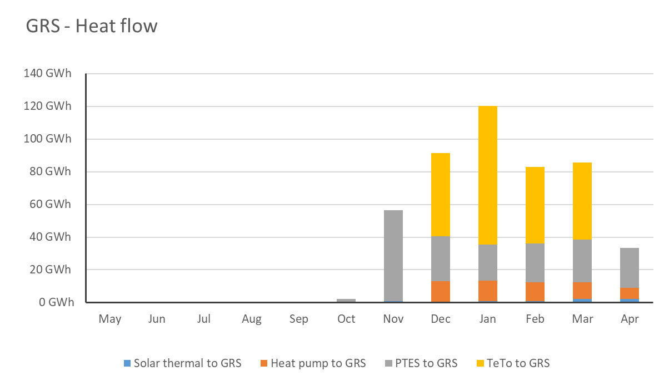
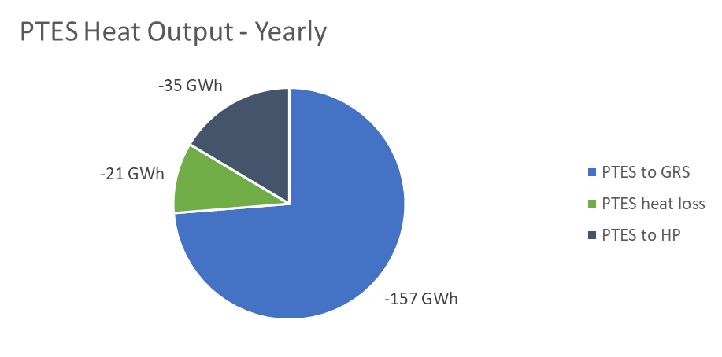
Yearly heat flow

Slide 10
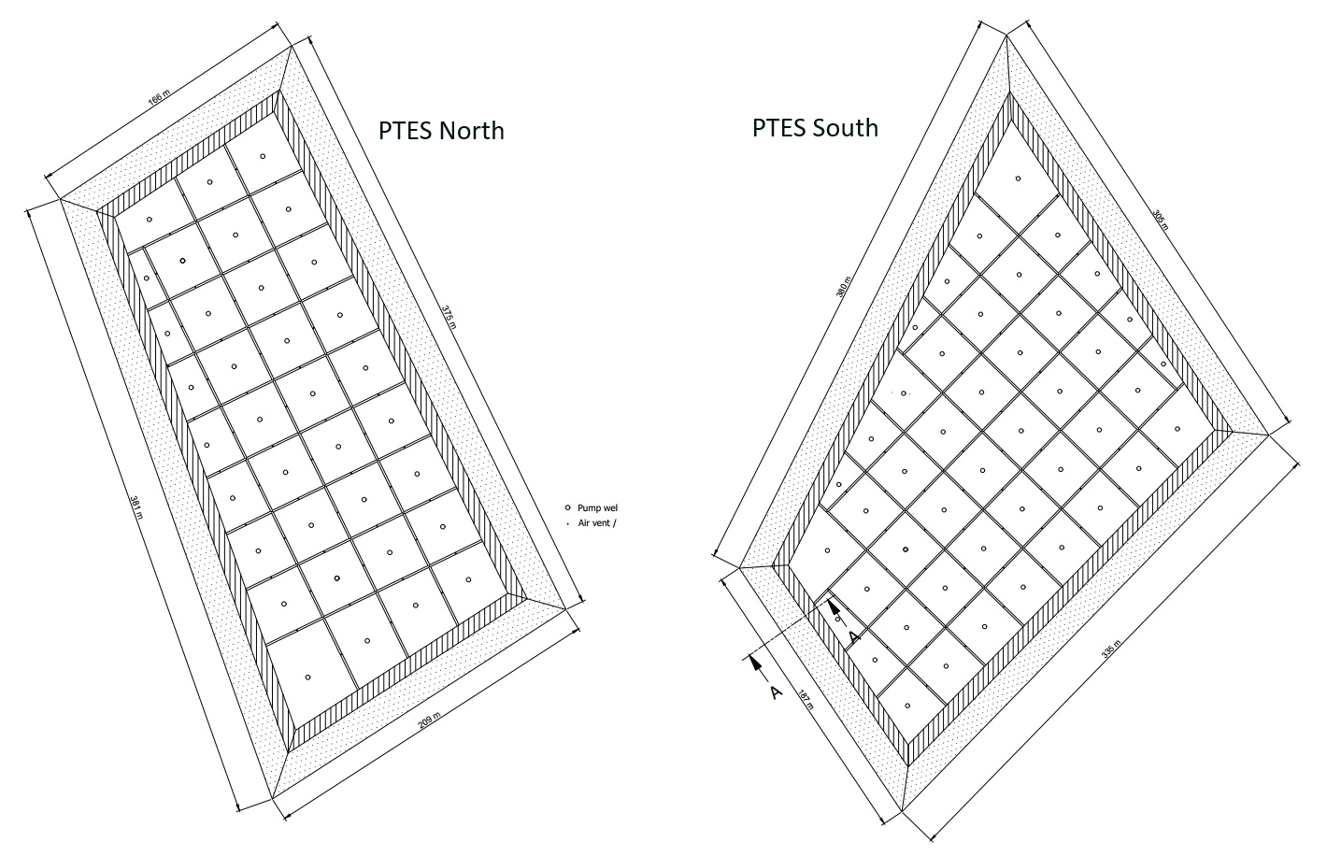
PTES Design
Volume of North: 383,186 m³
Volume of South: 486,661 m³
Charge/discharge: 106 MW

Slide 11
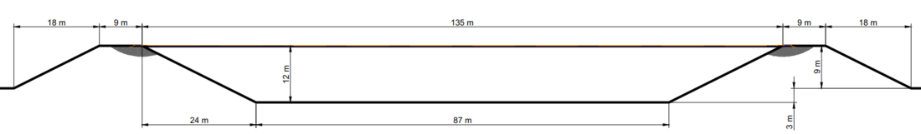
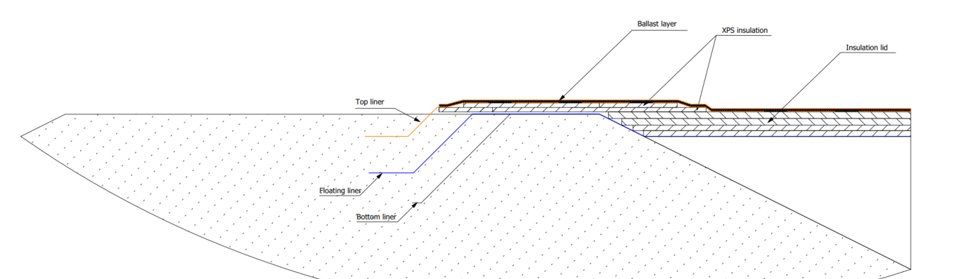
PTES Cross section

Slide 12
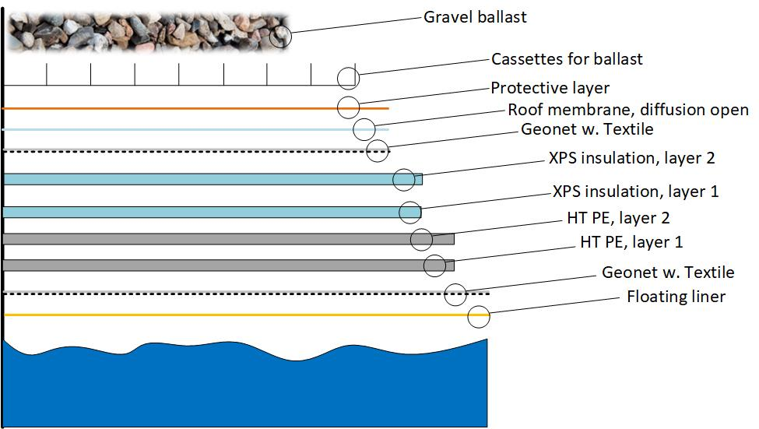
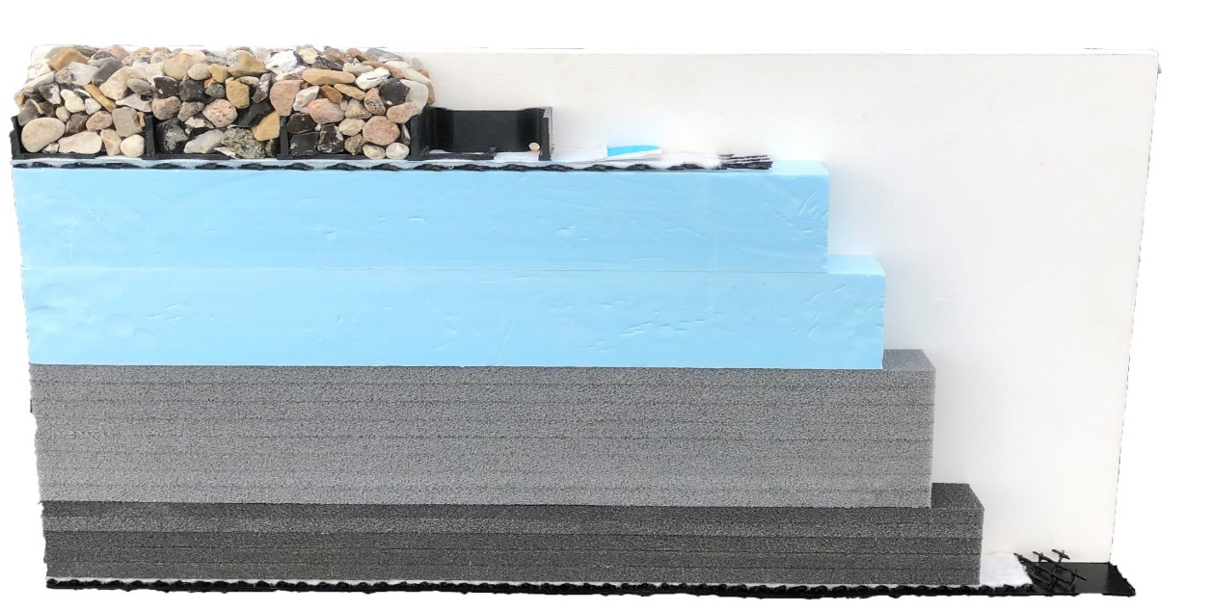
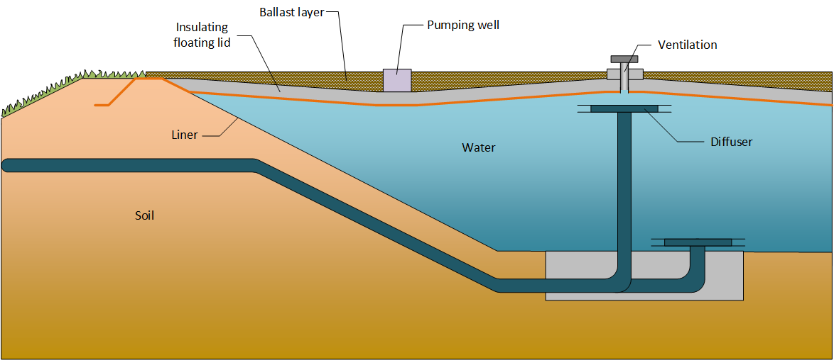
PTES LID
Ballast
Insulation
Top layer
Middle layer
Bottom layer
Floating liner

Slide 13
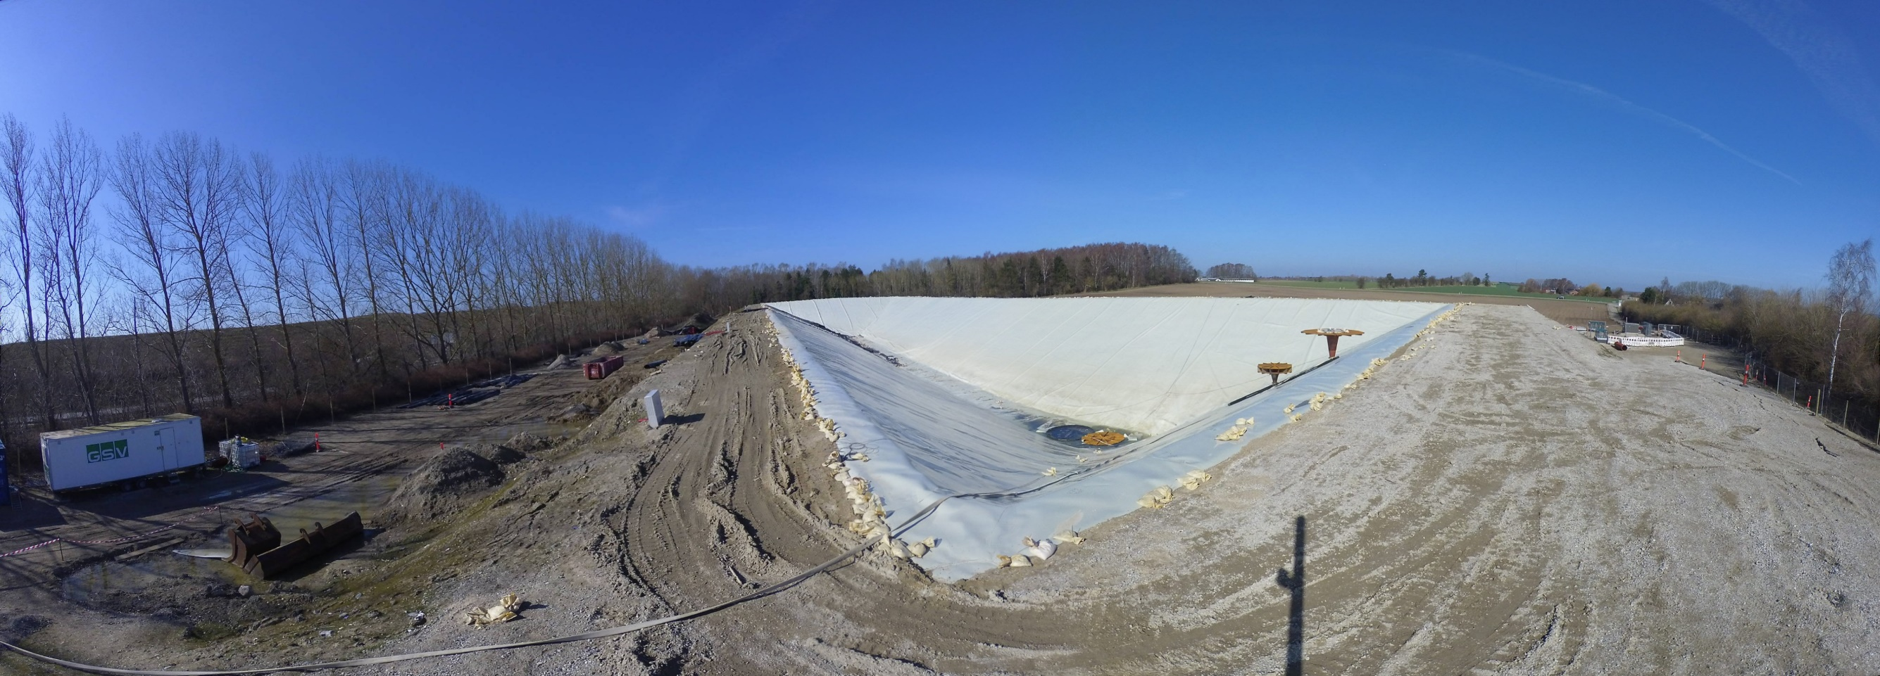
PTES Construction - Lining of sides and bottom

Slide 14
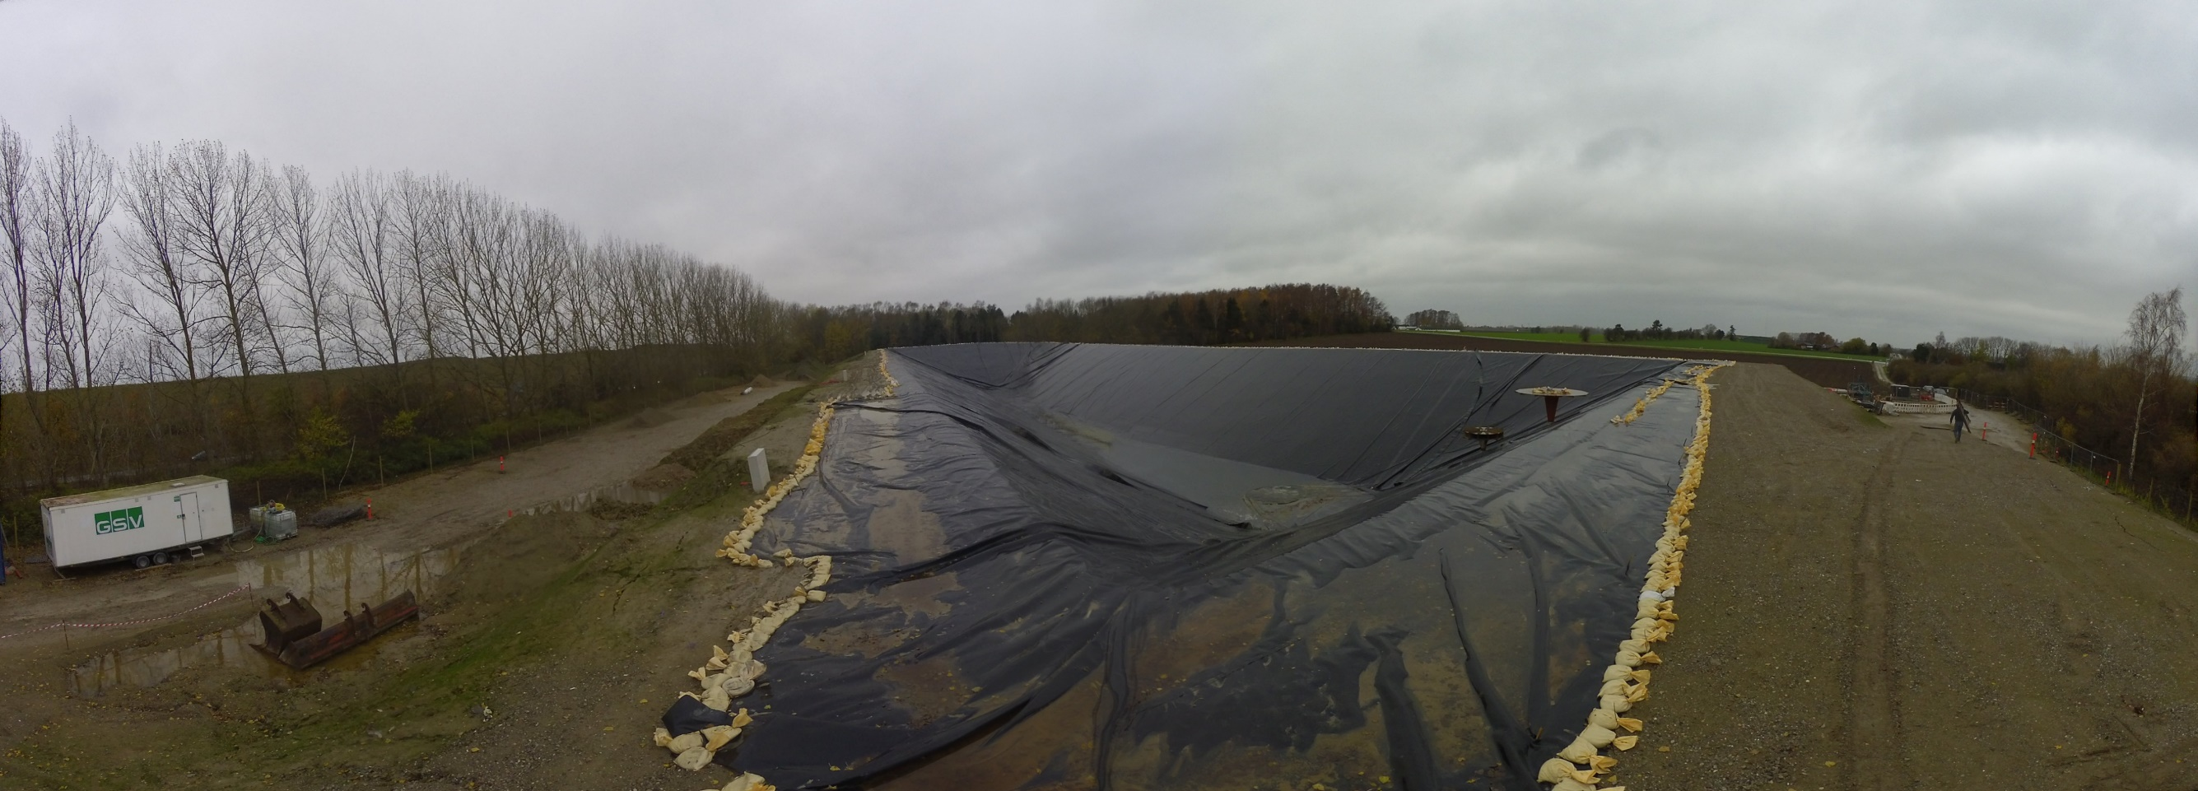
PTES Construction - Protection liner

Slide 15
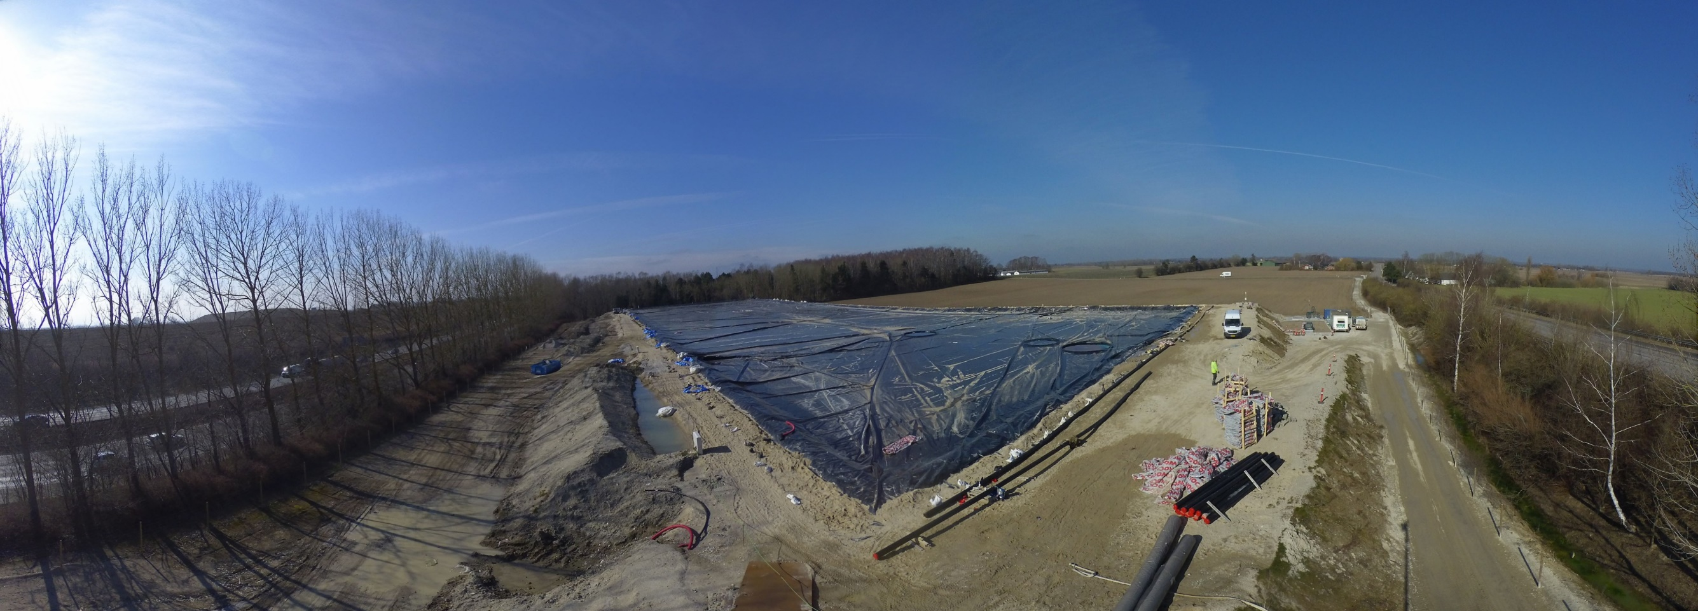
PTES Construction - Filling storage with water

Slide 16
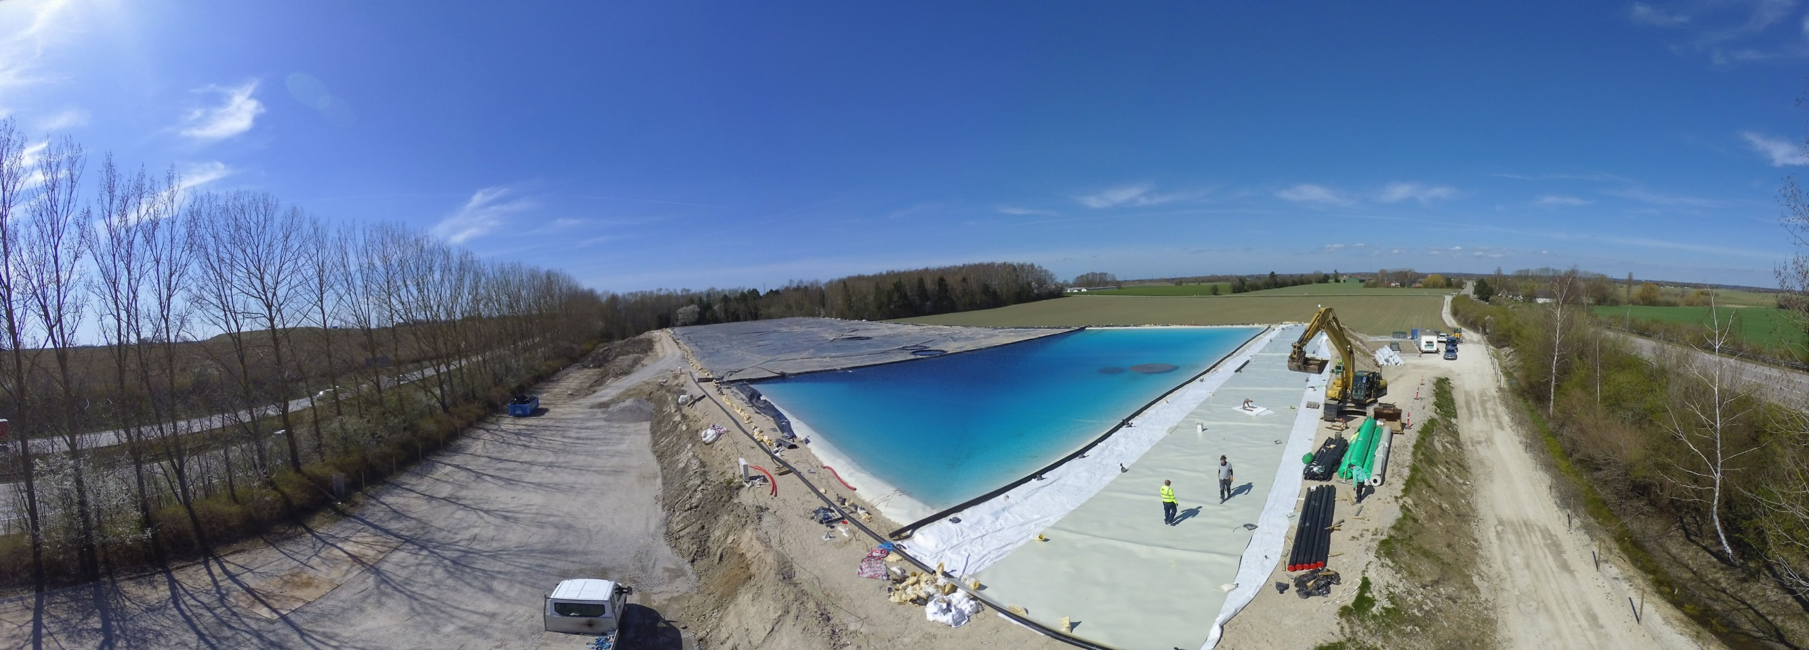
PTES Construction - Installation of floating liner

Slide 17
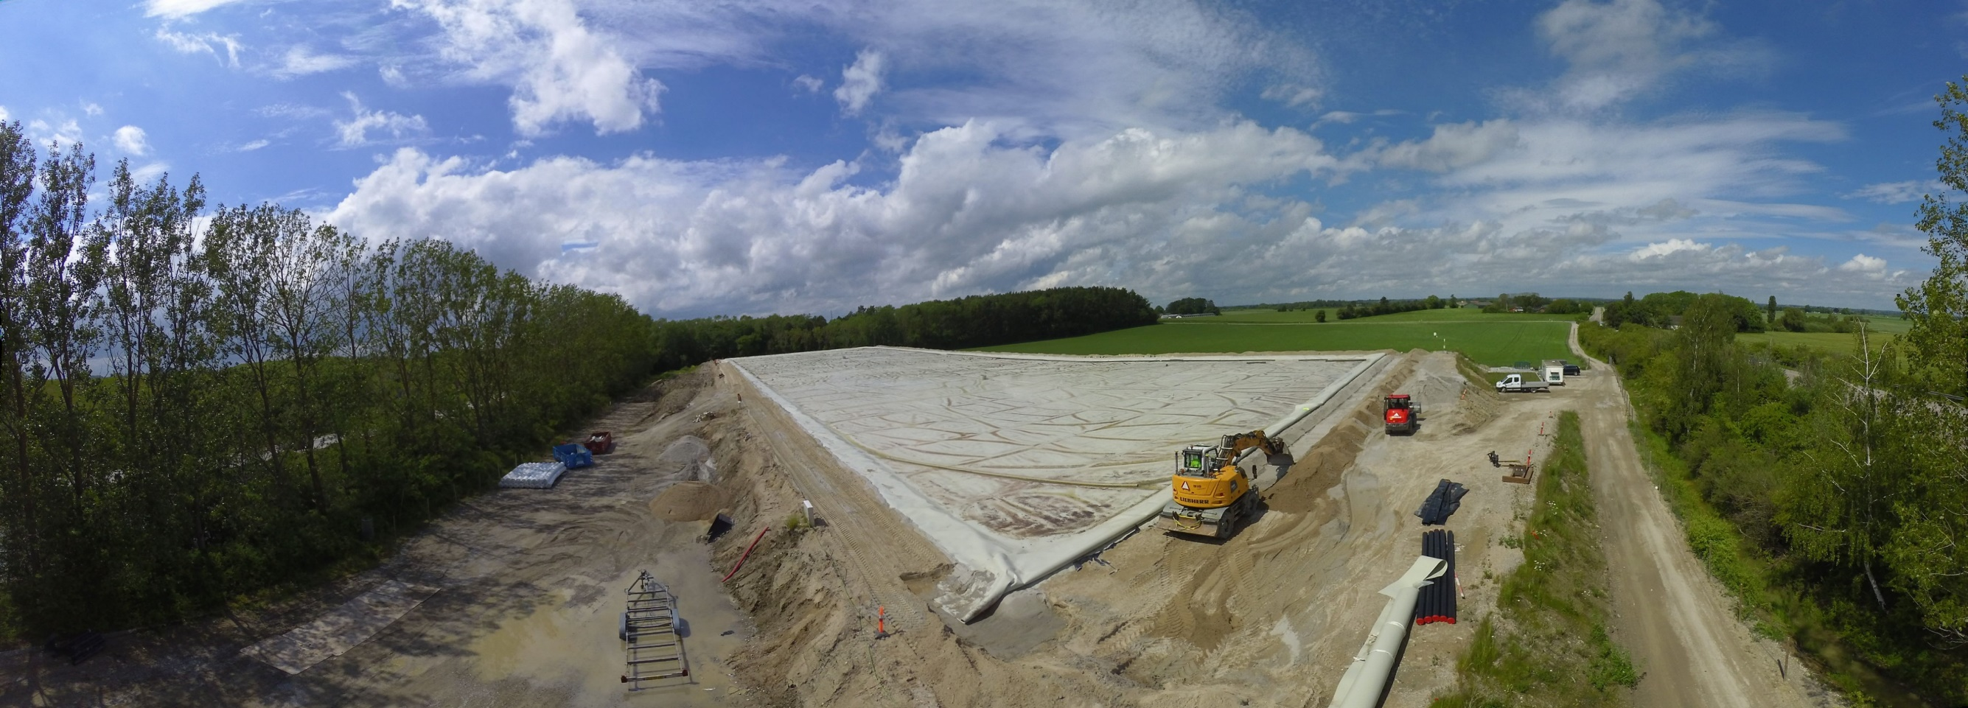
PTES Construction - Installation of floating liner

Slide 18
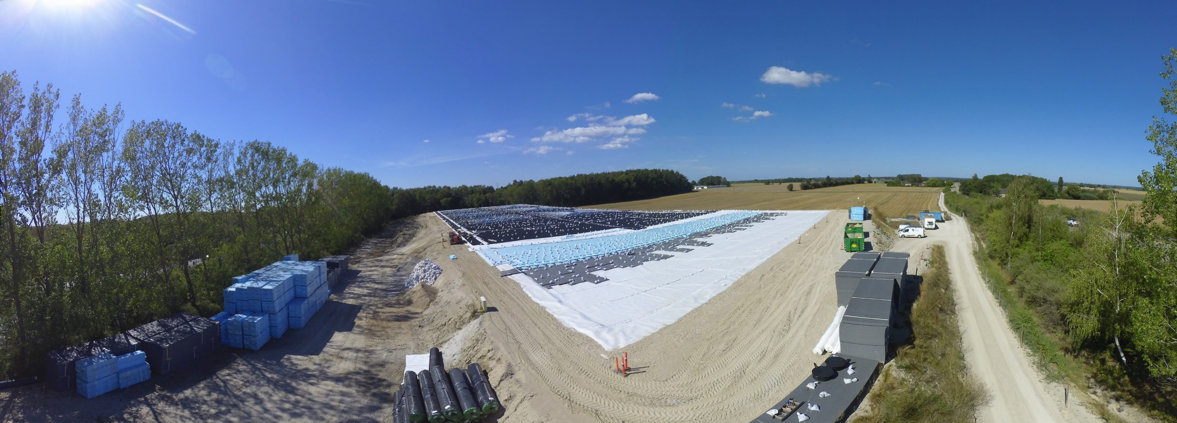
PTES Construction - Installation of insulation layers

Slide 19
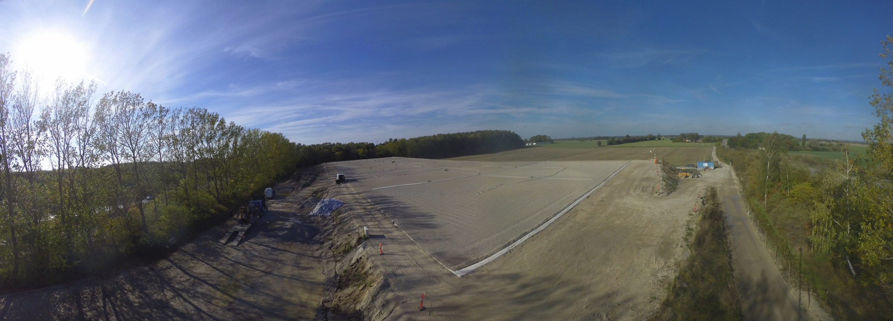
PTES Construction - Ballast installed

Slide 20
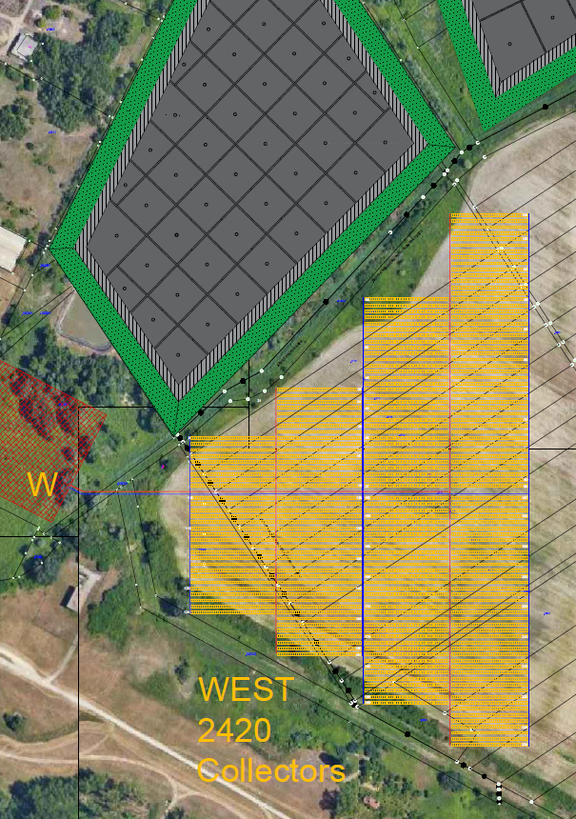
Solar thermal FIELD
Collector area: 38,623 m²
Collectors: 2420
Yearly production: 29,067 MWh

Slide 21
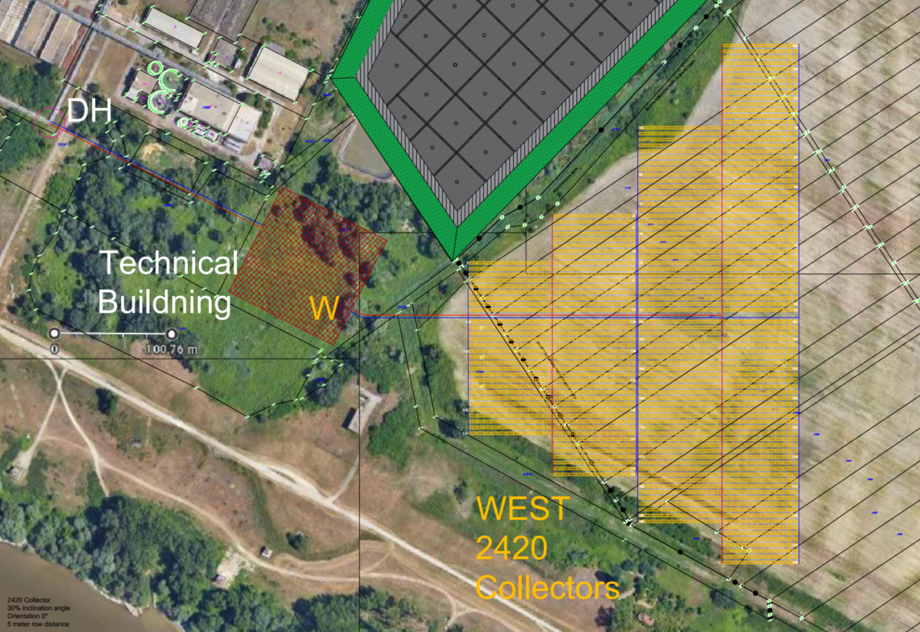
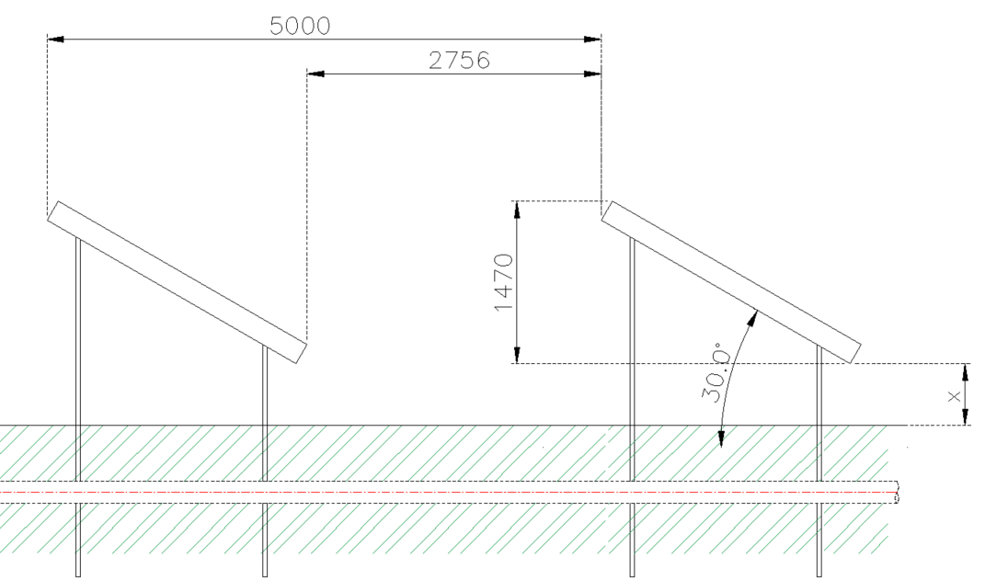
solar FIELD
Technical Specifications | Value | Unit
Total gross collector area | 38,623 | [m²]
Number of solar collectors | 2,420 | [-]
Approximate land footprint | 74,172 | [m²]
Secondary side temperatures (return) | ~10 | [°C]
Collector installation angle | 30 | [°]
Collector azimuth angle | 0 | [°]
Distance between collector rows | 5 | [m]
Solar field operating heat transfer fluid (HTF) | 30% Propylene Glycol / Water | [-]

Slide 22
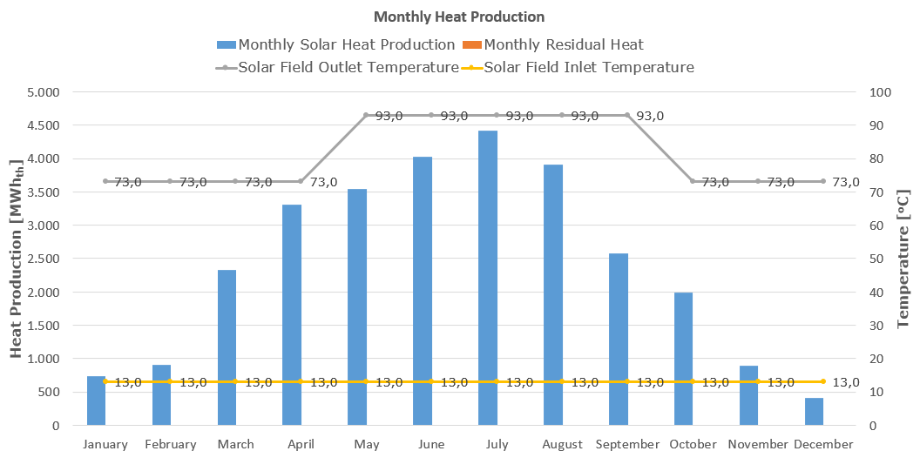
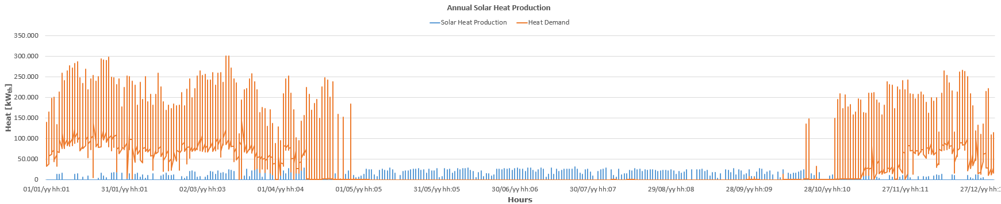
solar FIELD Performance Simulation
Solar Field Specifications | Value | Unit
Peak thermal output (gross) | 31,21 | [MW_{th}]
Annual thermal yield (gross - reference year) | 29,067 | [MWh_{th}]
Annual thermal yield (net - reference year) | 28,195 | [MWh_{th}]
Maximum expected daily thermal yield (gross) | 220.54 | [MWh_{th}]

Slide 23
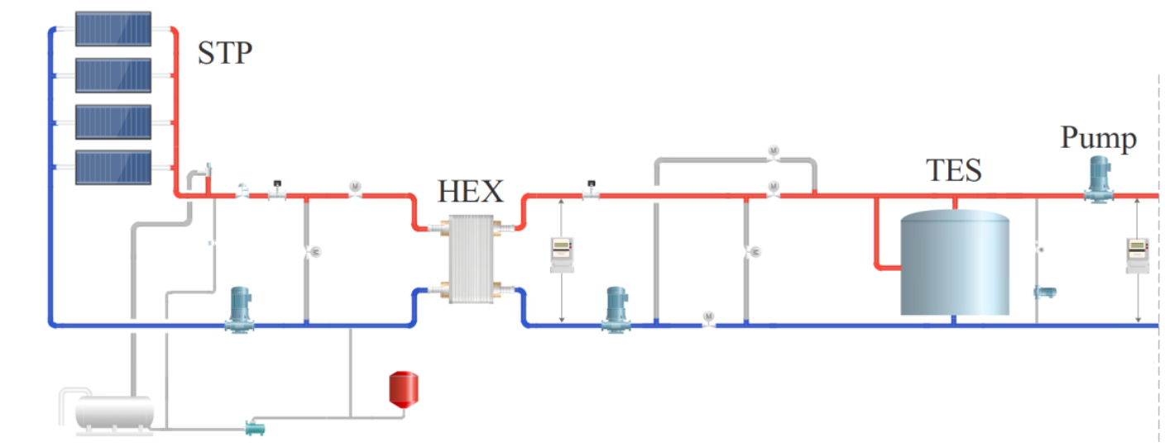
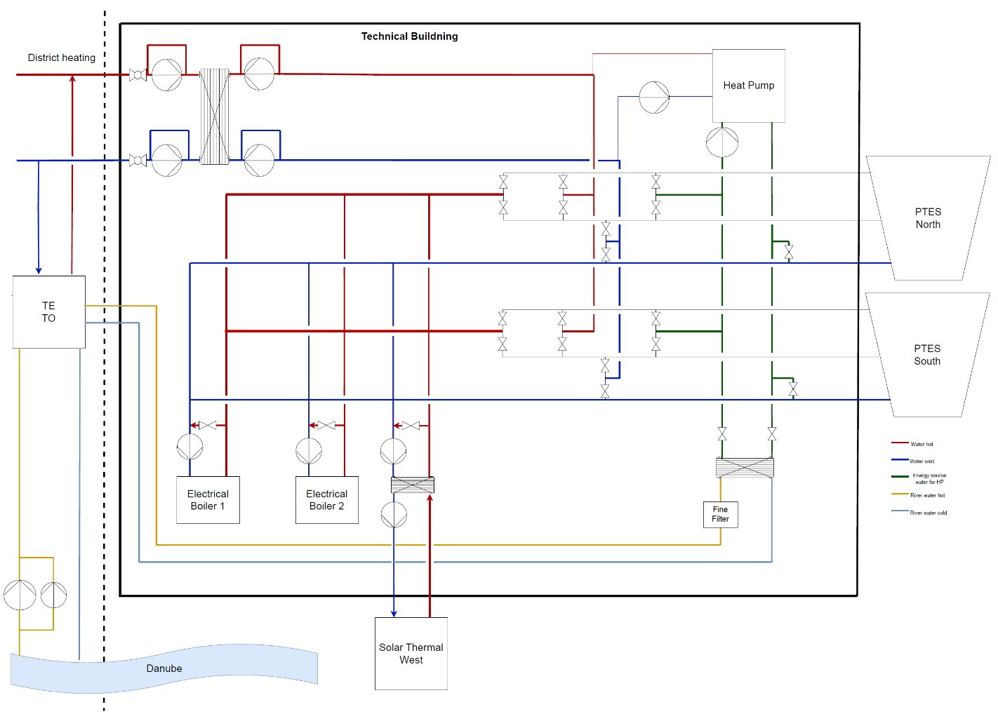
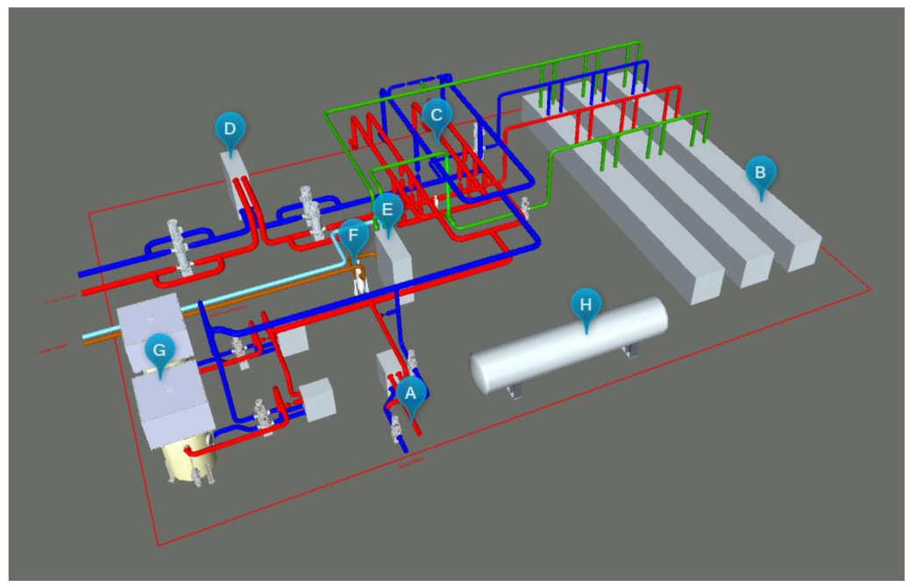
solar thermal plant

Slide 24
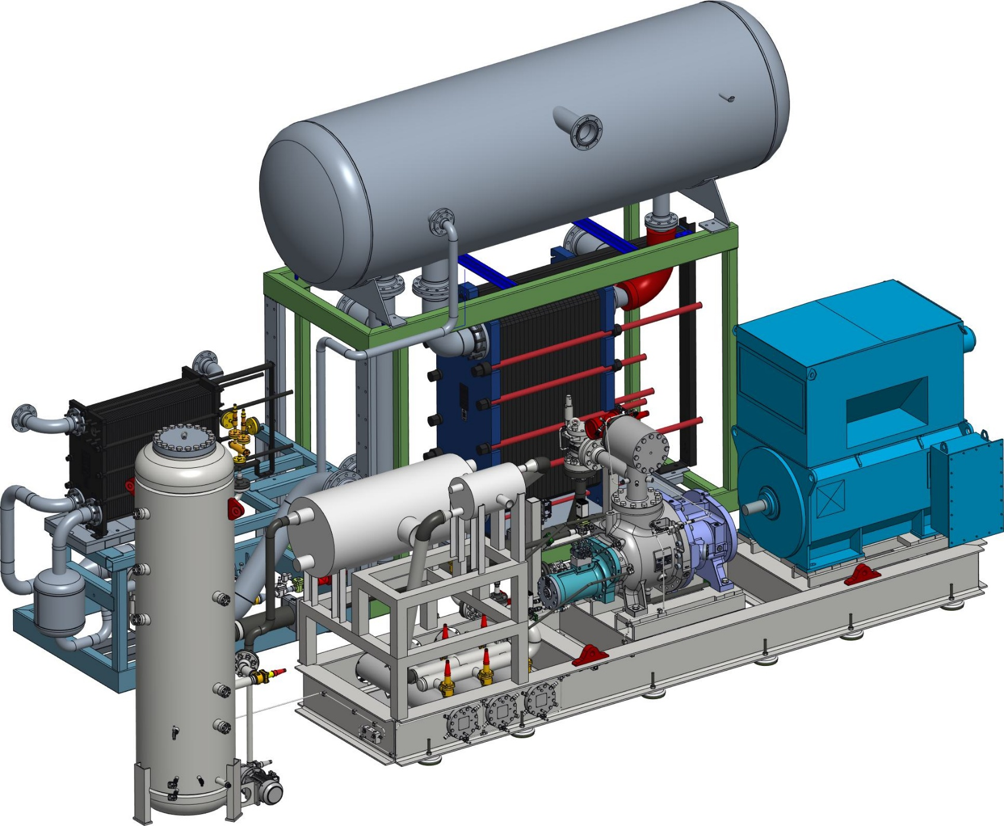
Heat pump station
Heating power: 17 MW
COP: 3.49
Dual source
Output temperature: 90 °C

Slide 25
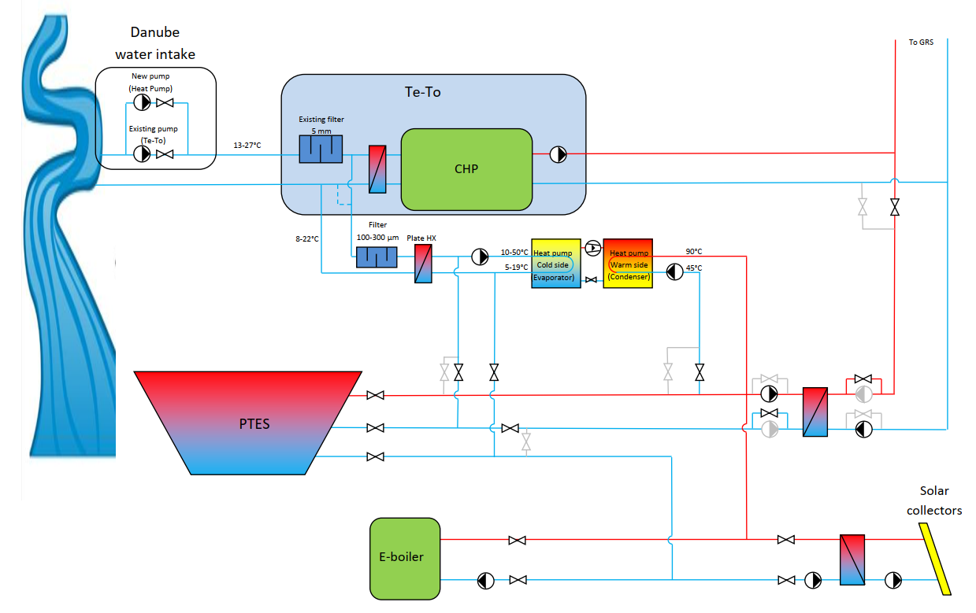
HEAT PUMP Operating principle
Non-heating season
Heat from Danube
Heat to PTES
Heating season
Heat from PTES
Heat to Novi Sad

Slide 26
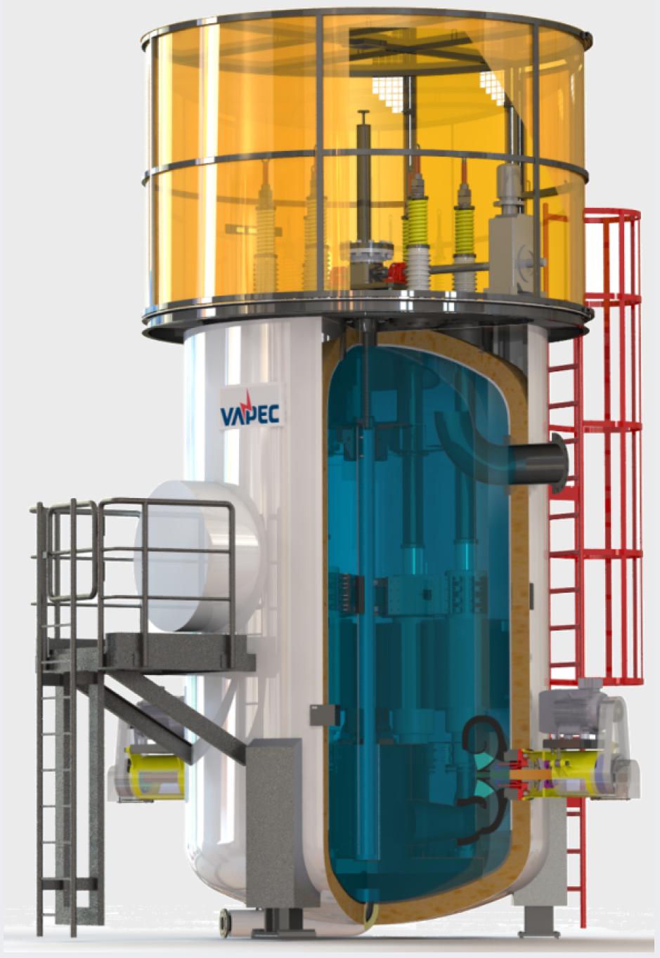
Electric boiler
Thermal power: 2x30 MW
Voltage: 20 kV
Efficiency: >99%

Slide 27
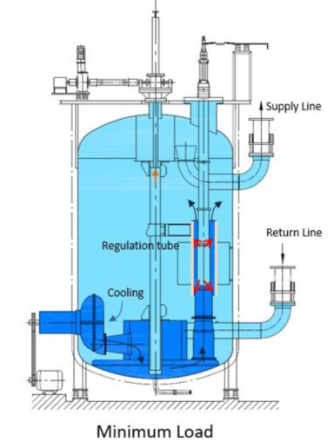
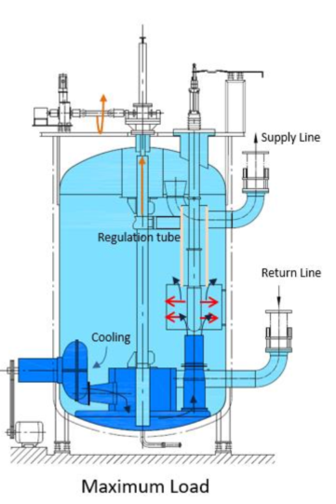
eBOILER OPERATING PRINCIPLE

Slide 28
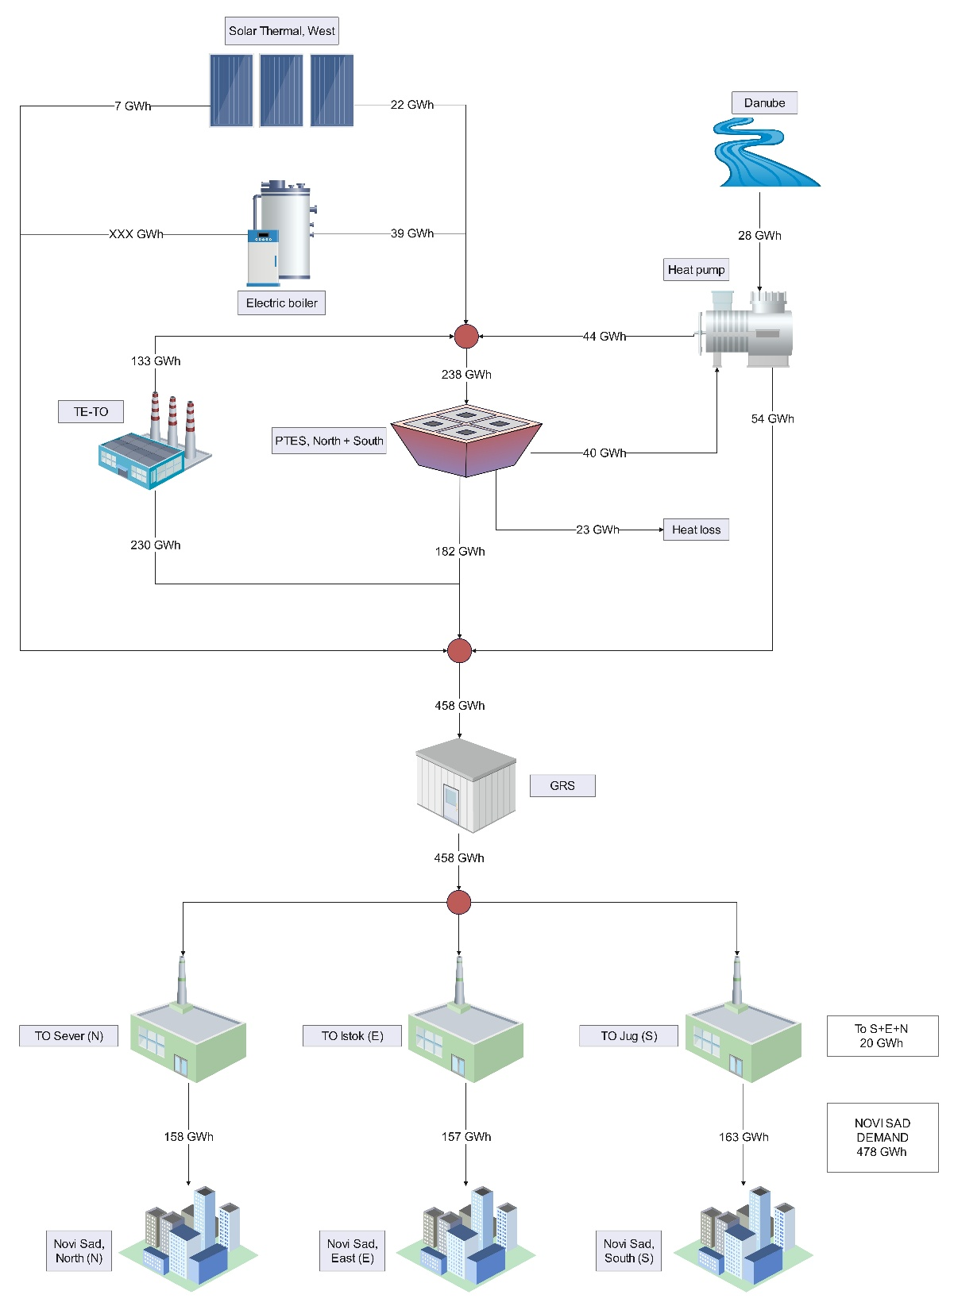
Summary

Slide 29

Summary - ENERGY BALANCE
Heat Balance | Total [GWh]
Heat Demand (North+East+South) | 478
Solar thermal to PTES | 22
Heat pump to PTES | 44
Eboiler to PTES | 39
TeTo to PTES | 133
River Danube to HP | 28
PTES to HP | 40
Electricity to HP | 33
PTES heat loss | 23
PTES to GRS | 182
Solar thermal to GRS | 7
Heat pump to GRS | 54
TeTo to GRS (Heat supply from TeTo) | 230
Heat supply from local boilers (North+East+South) | 20

Slide 30


Summary - COST BENEFIT ANALYSIS
EBRD Financing:
Sovereign loan of EUR 80 million to Republic of Serbia
Co-financed by EUR 25 million investment grant from the European Union through the Western Balkans Investment Framework (WBIF)
On 27 December 2024, the Loan Agreement and the Project Agreement for the financing of the Solar-Thermal Novi Sad project were signed.
The project implementation is planned for the period 2026–2028.
Overall CAPEX - Solar-thermal Novi Sad
PTES | 48.850.000
Solar thermal field | 11.900.000
Heat pump system | 12.877.500
River water supply and filtration at TE-TO | 4.235.000
eBoilers Plant | 4.650.000
Transformer and electrical connection for E-boilers | 2.500.000
Technical Building | 4.005.000
Technical installation | 6.187.400
Works and supplies | 95.204.900
Contingency (10%) | 9.520.490
Total | 104.725.390
Scenario with grant financing
EIRR | % | 12%
ENPV | EUR | 40,083,333
E. Payback Period | years | 9

Slide 31




Hvala na pažnji!
Dušan Macura
dusan.macura@nstoplana.rs

