Slide 1

Introduction of CSH EMEA hub Predictive team
Vasilije KODŽOPELJIĆ, Senior Service Sales Reprezentative
SCHNEIDER ELECTRIC SRBIJA D.O.O.

Slide 2
The Team

Slide 3
CSH EMEA Master hub
Europe Hub
NAM Hub
India Hub with 24/7 Global Remote Operations center

Slide 4
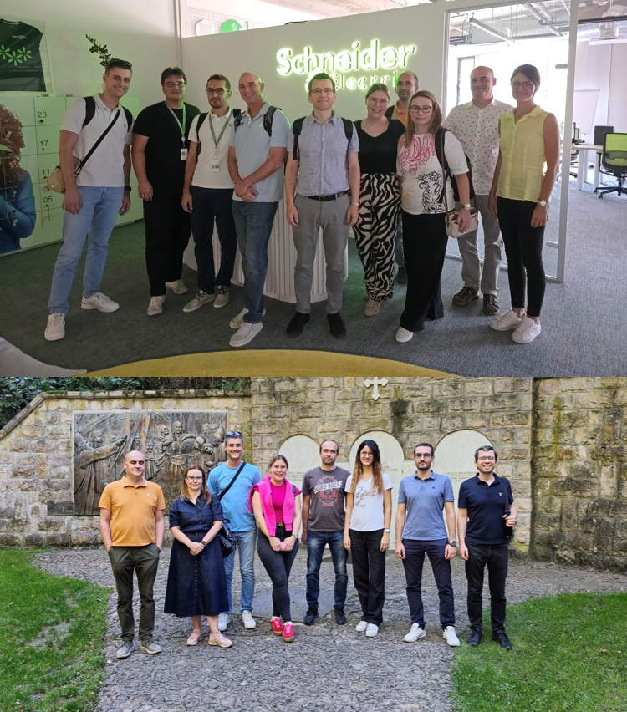
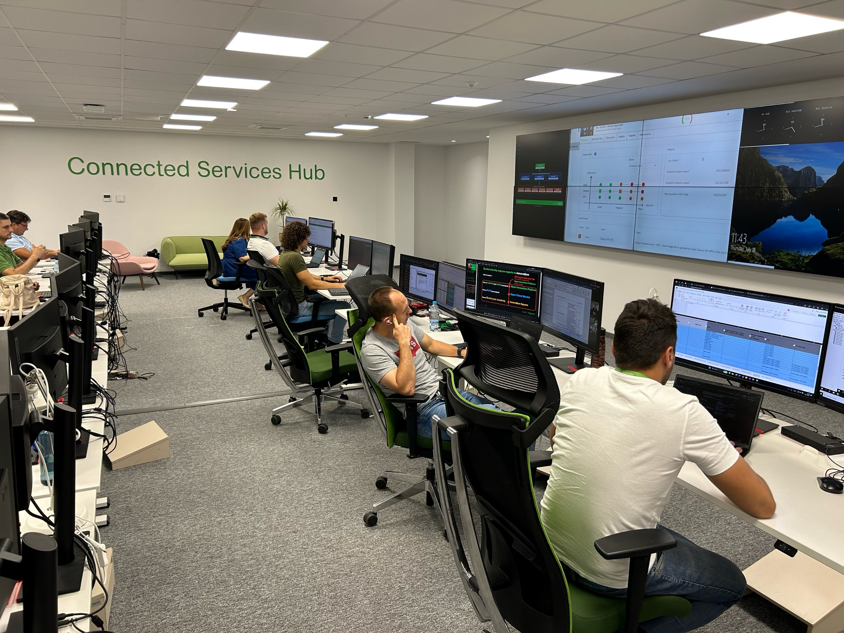
Connected Services Hub Team in Serbia
SEE video about the team in Novi Sad (link)

Slide 5
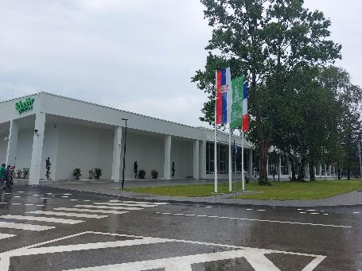
Novi Sad was selected to become the European Master Hub 3 years ago
1
Major SE Hub for Digital Grid, which is part of Digital Energy, like CSH
Strong technical universities and many strong technical profiles in the market
Strong support from local Management : HR, Talent acquisition, Finance, business
Cost effective
2
Academic and Professional background of the CSH team in Serbia:
9 members with 52 years studding on Universities
All members with Electrical Engineering university competences (MSc or PhD)
75 years of professional engineering experience
27 years of team leading experience
3
4

Slide 6
The Offer

Slide 7


Why are we in this business ?
The pull for Digital Services
Leveraging leverage IOT and AI digital technologies
We can help businesses to focus on their core customers and operations
Managing on their behalf the complexity of their energy systems and assets
Adapting the delivery model to their preferences, from self-service mode (technology adoption) or to complete outsourcing.
More Electric
Material shortage
The number of energy assets will be X2 in the next 20 years
32% of retailers reported disruption in 2021
More Complex
Talent shortage
Hybrid electrical systems (Microgrids) will be X6 in the next 10 years
28% of power companies have skills shortage
Process Continuity Need
38% of factories have experienced production losses $3,000/h for each equipment failure incident
Confidential Property of Schneider Electric |
Page 7

Slide 8

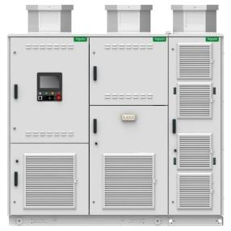

.
Increase uptime, maximize operational efficiency and contribute to your company’s sustainability goals
Up to 40% Less on-site activities and planned downtime *
Condition-Based maintenance allows to get the right maintenance at the right time.
24/7 expert monitoring & technical support remotely and on-site.
Life 💚
+25% *
Schneider Electric EcoStruxure Service Plan
up to
* These percentages are non-contractual and are based on Schneider Electric experience and expertise with respect to the main root cause of downtime observed and for which Schneider Electric has developed solutions.

Slide 9

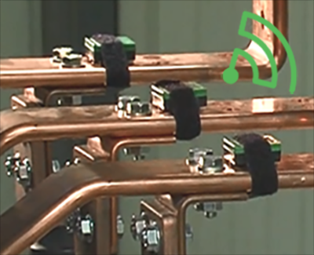
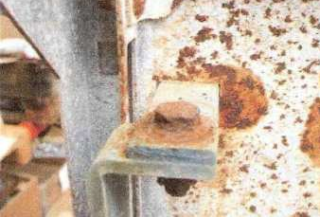
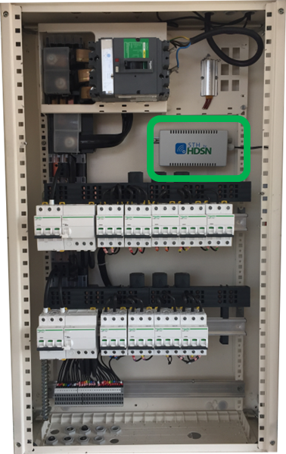
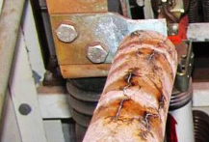
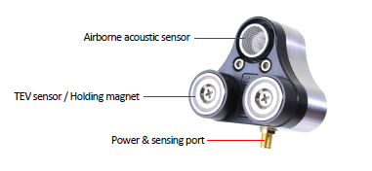


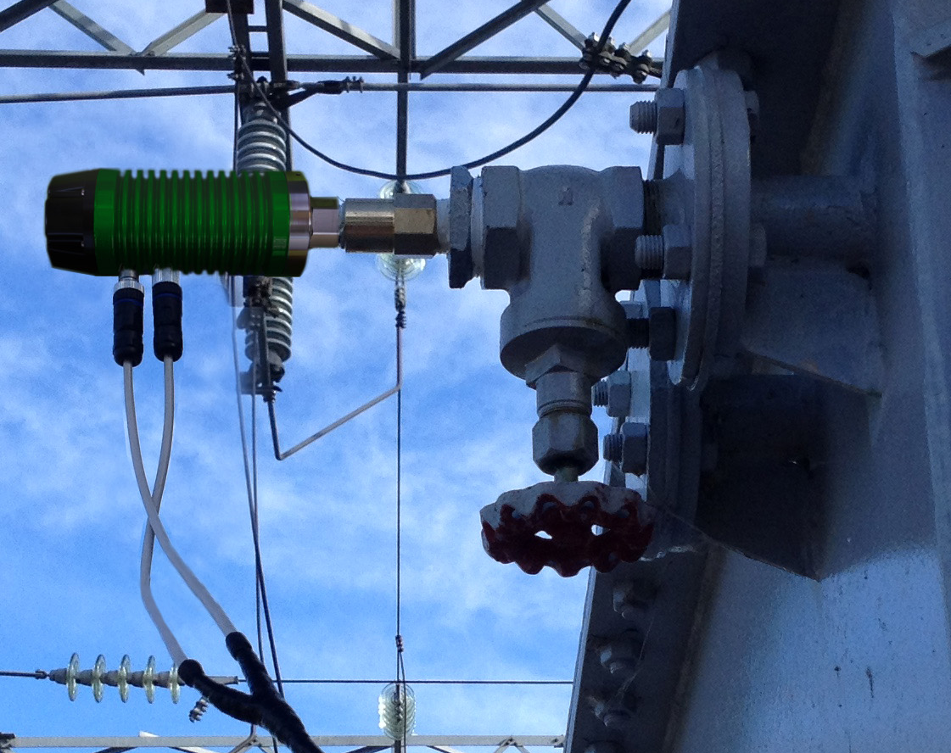
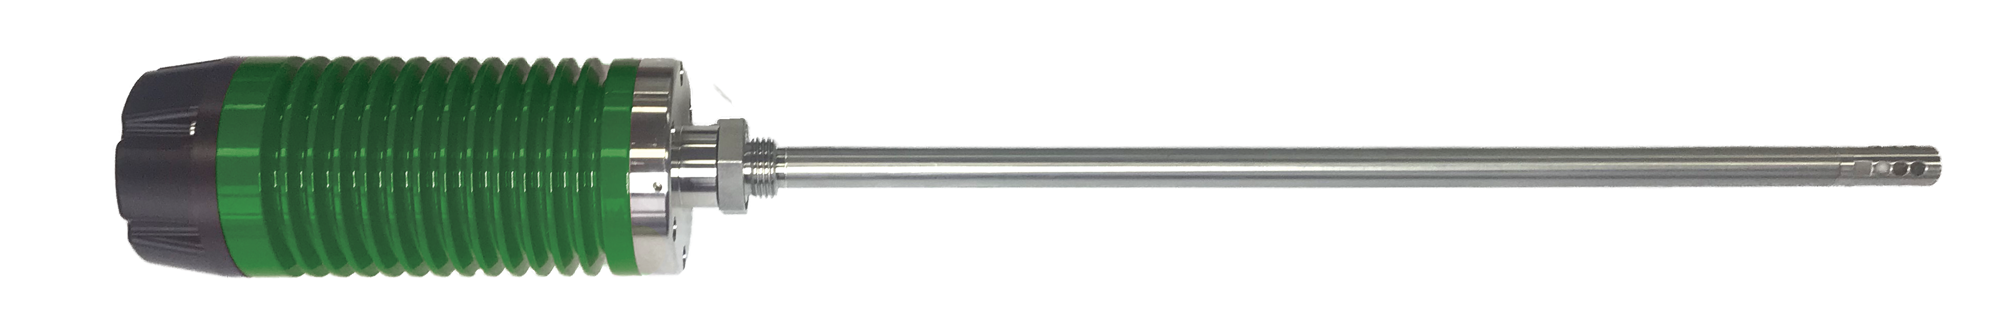
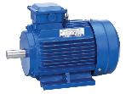
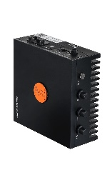
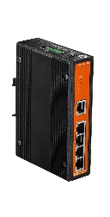
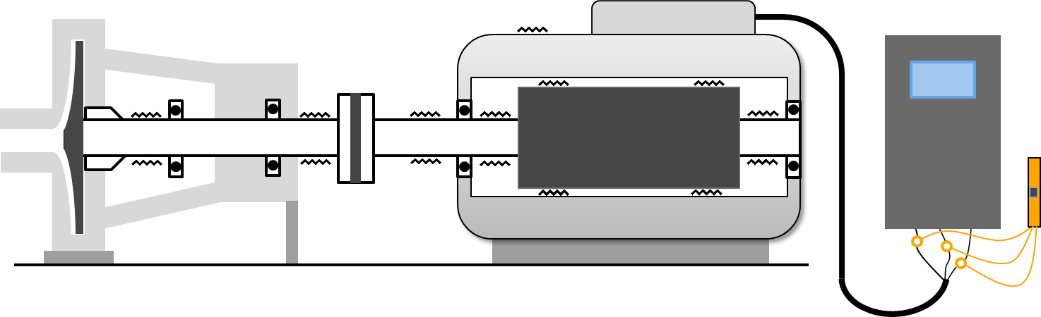
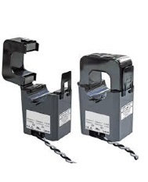

EcoStruxure Service Plan powered by sensors
Electrical connection made on field
Cable connection
Bus bar connection
Circuit Breaker connection
Service condition
Ambient humidity
Ambient temperature
Pollution level
Partial discharge
Fire Risk
Thermal monitoring
Environmental monitoring
Partial Discharge
Fire Risk Prevention
Oil Transformer health Monitoring
Water content
Temperatures
Continuous Partial Discharge (PD)
Vibration
ETE Health Sensor
Motor Health Monitoring
Voltage
Current
Electrical Signal

Slide 10
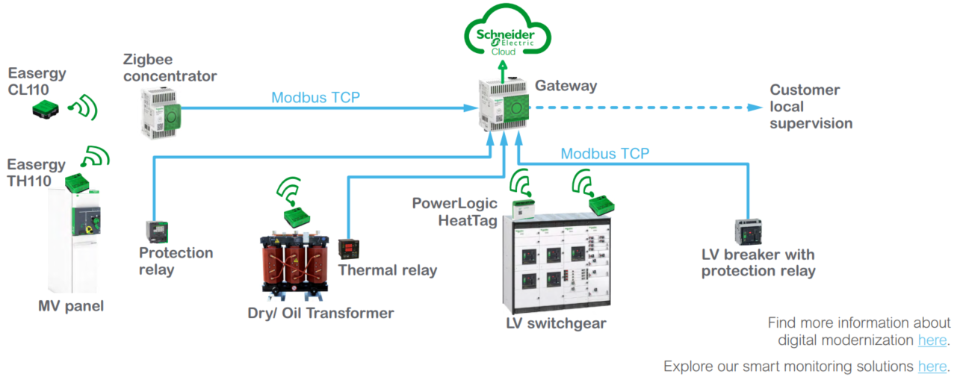
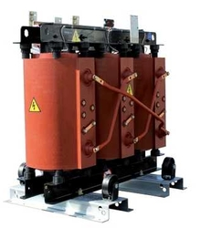
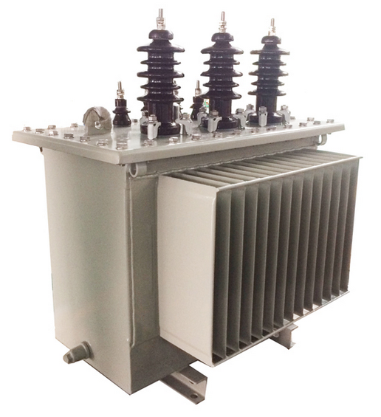
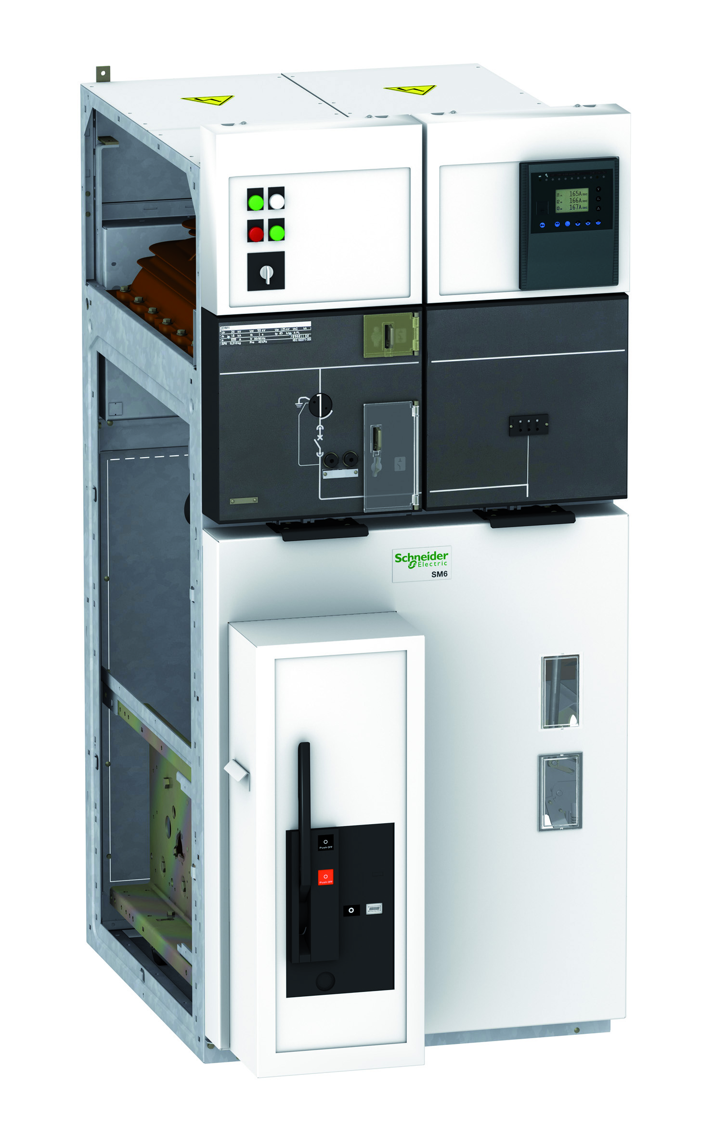
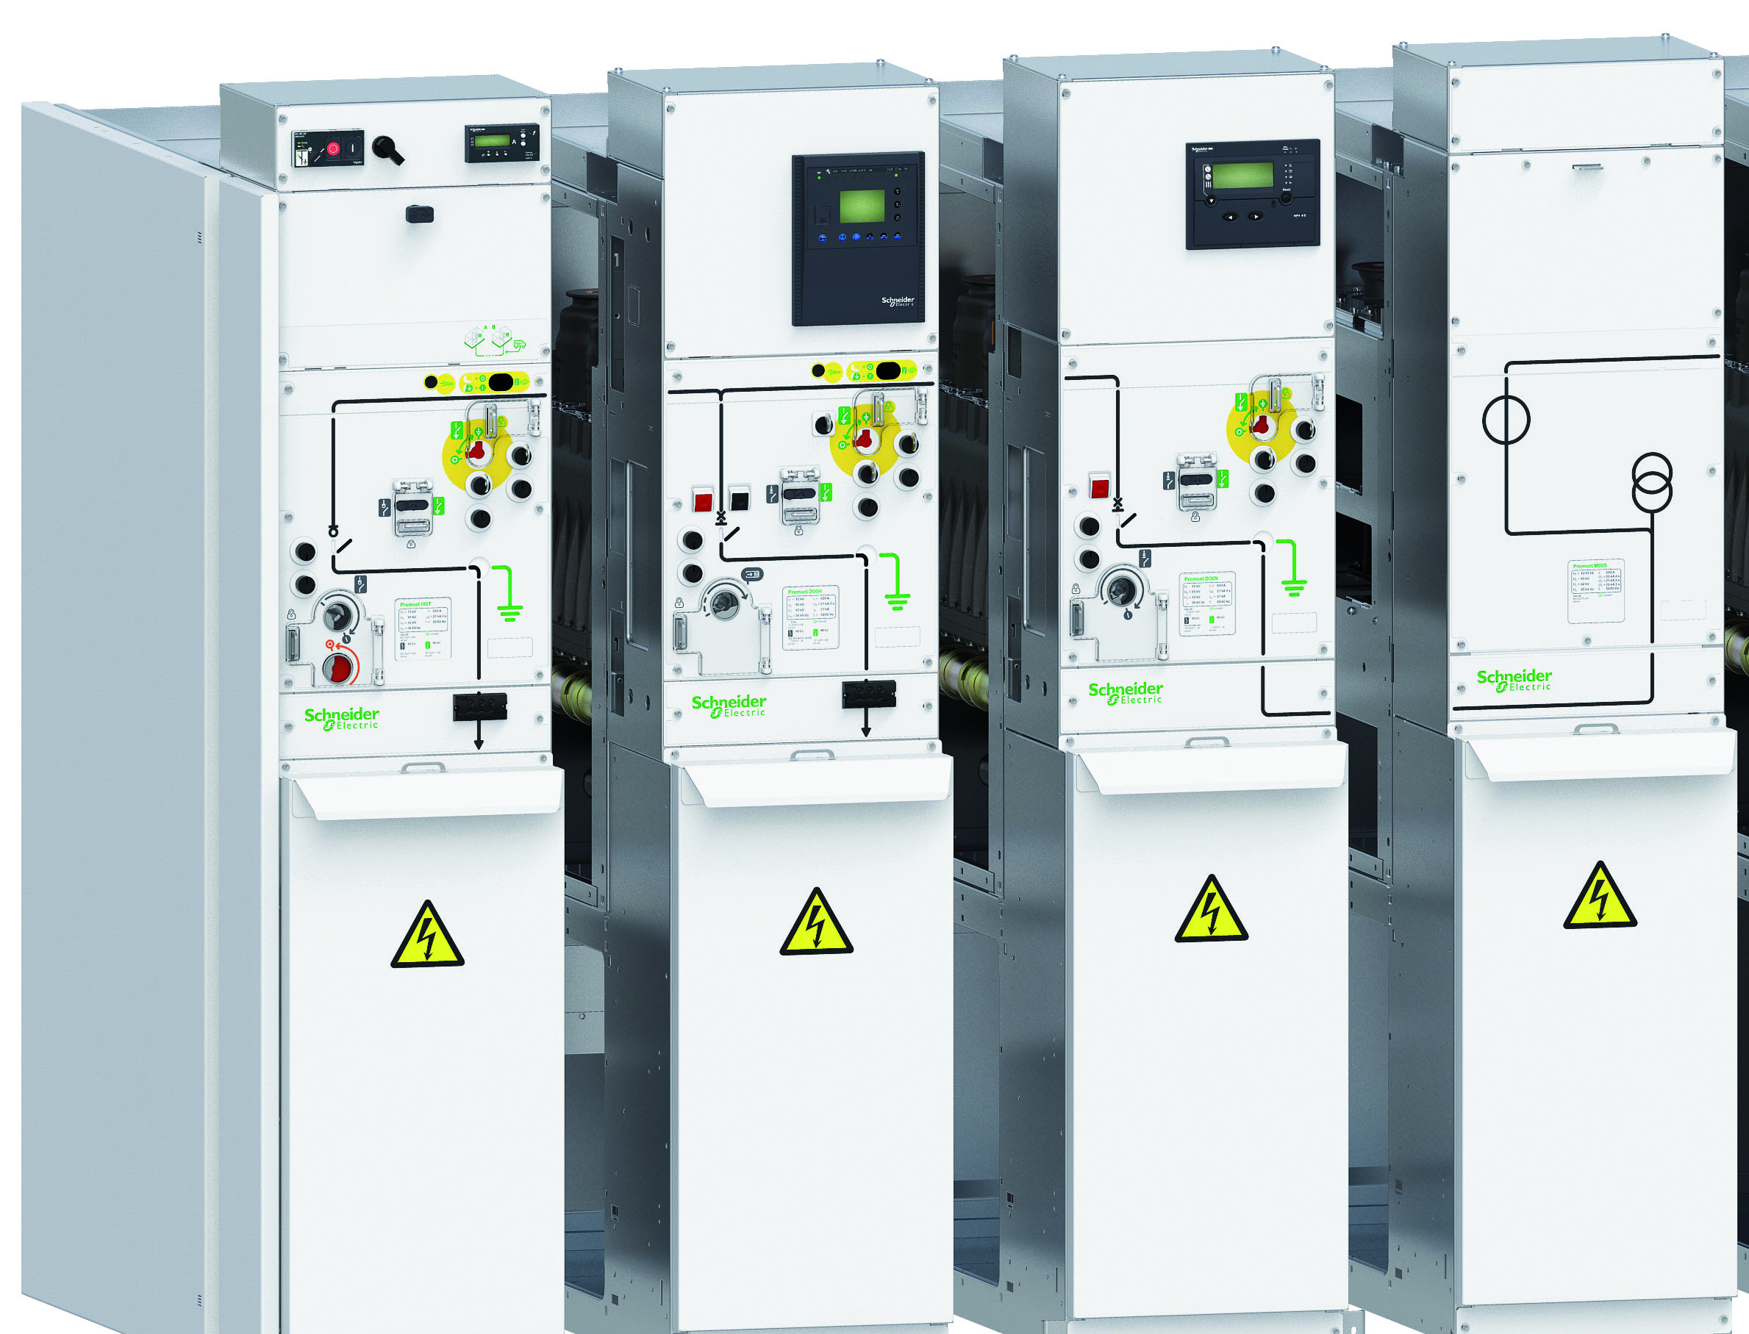
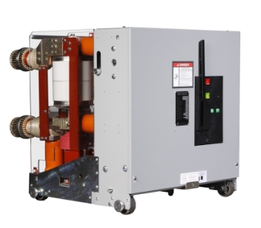
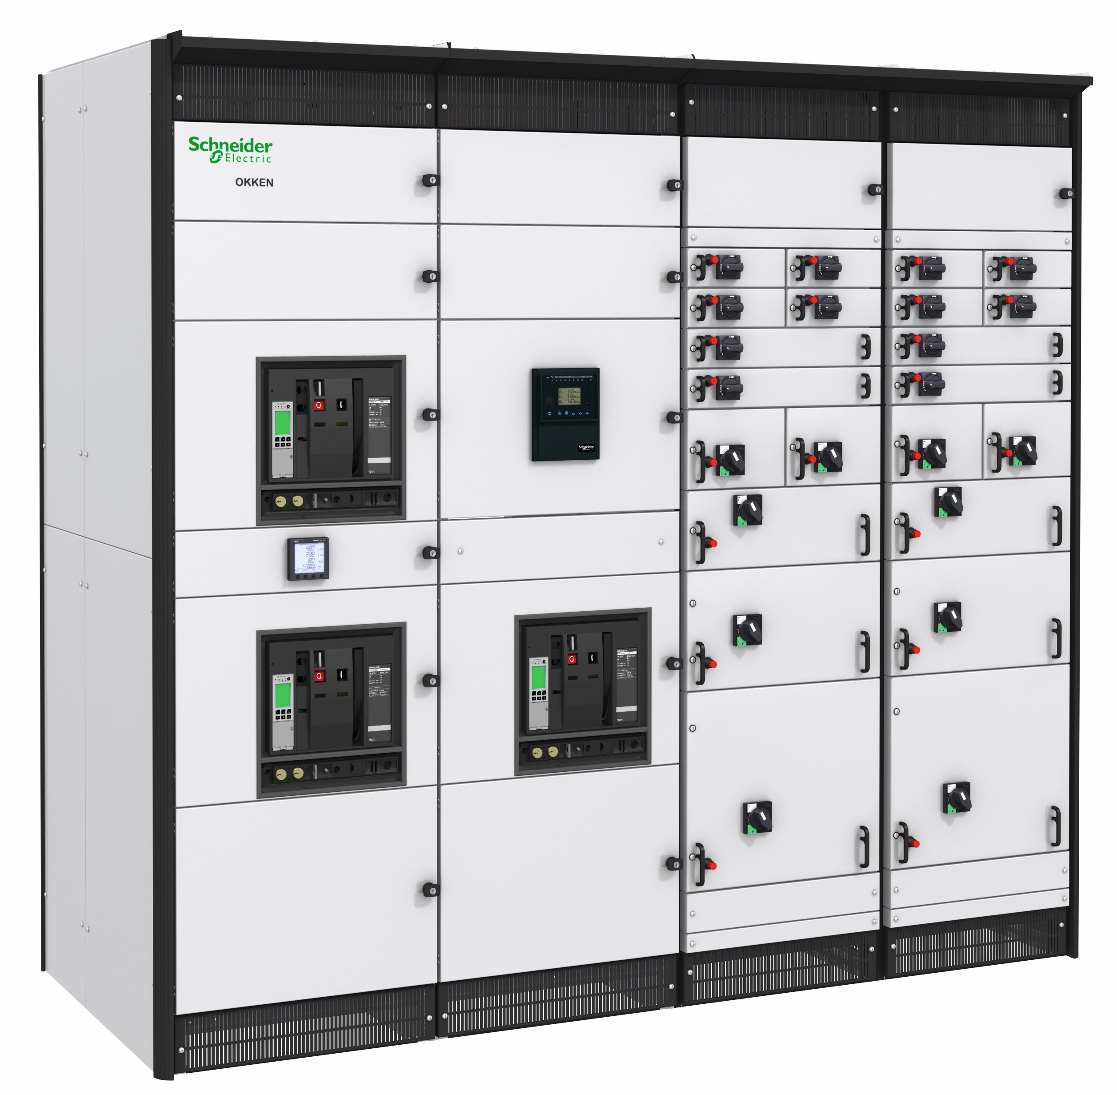
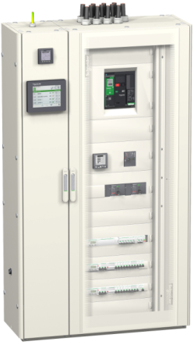

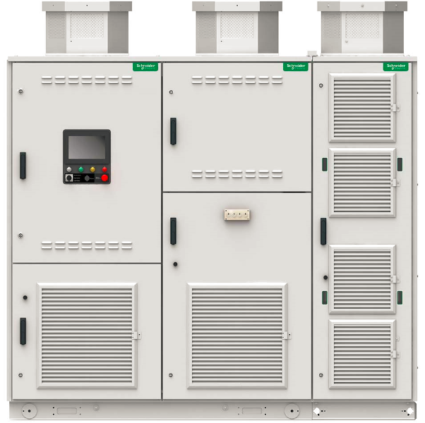
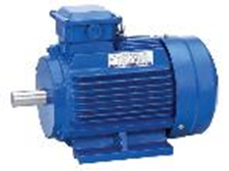
Architecture to enable EcoStruxure Service Plan
Connect your critical equipment and their IoT sensors
Dry Transformers
Oil Transformers
MV Switchgear
MV Breaker
LV Switchgear
LV Breaker
Drives
Motors
Transformers
Breakers, Switchgear and UPS
Rotating Equipment

Slide 11
Digital Services Value
Services:
24/7 Preventive Digital monitoring
Predictive and Optimization remote services
Technical Account Management
Resources:
125 Experts on Digital, Assets and Systems available for customers
One Global Remote Operations Center 24/7
Three main locations for customers & operations proximity
Scope:
Supporting more than 140 countries
900k worldwide connected devices
24/7 / Multi-country / Multi-sites capabilities
Deliverables:
Optimized customer operations: Efficiency, Resiliency, Safety, Cybersecurity, Sustainability
+500k Incidents & alarms treated/year
~30k Site periodic reports, ~1500 Expertise Reports
High Customer Satisfaction (NSS 72%)
Offers supported:
EcoCare & ESP services contracts
Secure Power & Cooling
Electrical Distribution & Power Systems
Building Advisor
Industry Drives & Rotating machines

Slide 12
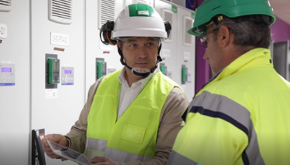

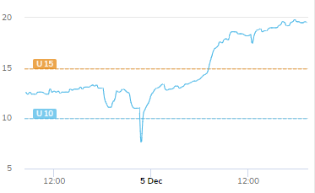

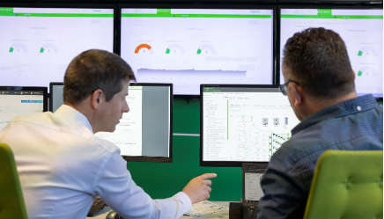
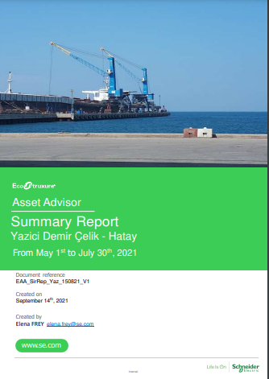
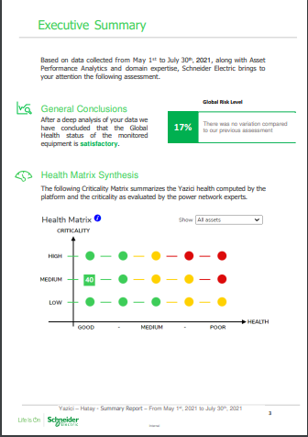
The best of Field Service & Digital packaged in one contract
Initial Maintenance Planning
Site Maintenance Intervention
New Optimized Maintenance Planning
FIELD
Event Detection
DIGITAL
Site Monitoring
Pull Through Business Identification
Complementary Platform Provisioning
New Maintenance Frequencies
Summary Predictive Report

Slide 13
EcoStruxure Service Plan (Asset Management)
“ Save operating time and budget
while increasing your business continuity
with the right maintenance at the right time”
« Reduce operating cost while mitigating electrical failure risk up to 60%* »
« Mitigate electrical failure risk up to 77% »
Option : « Get a customized maintenance plan »
« Mitigate electrical failure risk up to 65% while reducing maintenance activities up to 25% »
« Best electrical failure risk mitigation up to 77% with best maintenance activities reduction up to 40% »
 | Prevent | Predict | Plus | Prime
Support | New : EAA + SLA
24/7 remote support and technical assistance | ● | ● | ● | ●
On-Site emergency technician dispatching - local SLA | ● | ● | ● | ●
Maintain
Preventive scheduled maintenance, including asset diagnostic - ProdiagTM tools |  | Prodiag with option CBM* | ● | ●
On-site technician intervention - troubleshooting or unscheduled preventive incl. labor & travel |  |  |  | ●
Spare parts to repair |  |  |  | option
Monitor
On-line customer portal | ● | ● | ● | ●
Ambient monitoring & alarming | ● | ● | ● | ●
Asset data monitoring and alarming | ● | ● | ● | ●
Electrical fire risk prevention – electrical connection & insulation | ● | ● | ● | ●
Asset health monitoring and diagnostics - predictive analytics (LV/MV Equipt, Dry Transfo) |  | ● |  | ●
Partial Discharge monitoring for Medium Voltage switchgear |  | option |  | option
Advanced Condition-Based Monitoring for Oil Transformer - predictive analytics |  | option |  | option
Optimize
Monthly automated asset data reporting | ● | ● | ● | ●
Advanced asset management & Power Quality consultancy |  | ● |  | ●
Dynamic asset maintenance plan recommendation |  | option* | up to +1Y | up to +2Y
* Option including Prodiag at contract starting, to enable dynamic asset maintenance plan

Slide 14

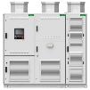
What’s Condition-Based Maintenance and how does it refocus your maintenance strategy?
1
No EcoStruxure Service Plan
How does a Condition-Based Maintenance actually works
Manufacturer maintenance
Intermediate maintenance
2022
2023
2024
2025
2026
2027
Manufacturer maintenance
Calendar-Based maintenance activities every year, regardless the assets condition.
With EcoStruxure Service Plan
2
The time between 2 manufacturer maintenance activities can be extended up to 2 years compared to a traditional maintenance contract.
2022
2023
2024
2025
2026
2027
And, in case of abnormal evolution of the maintenance index of the asset, the expert can call you for further investigation.
Depending on the maintenance index value, the expert shall propose to re-schedule the next maintenance in order to prevent failures and avoid downtime.
2 years
Notes:
Rotating Equipment

Slide 15
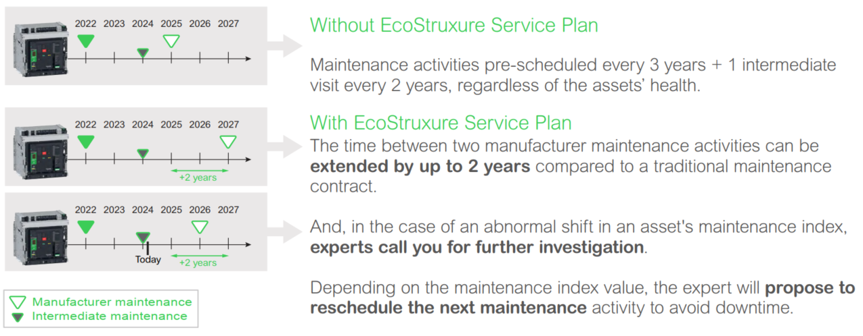
EcoStruxure Asset Advisor – Condition Based Maintenance

Slide 16
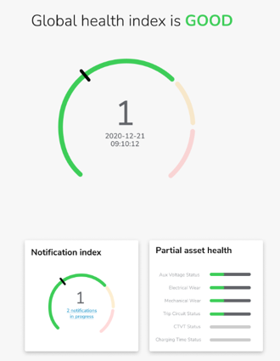
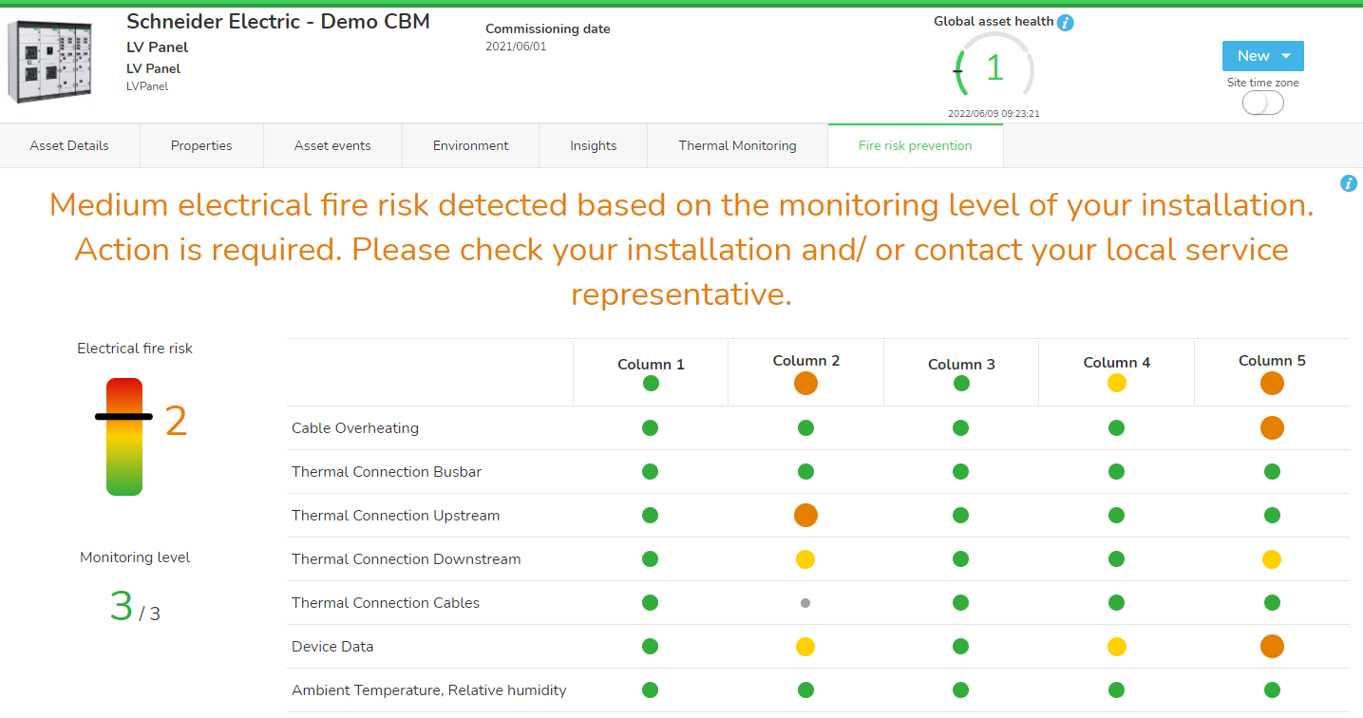
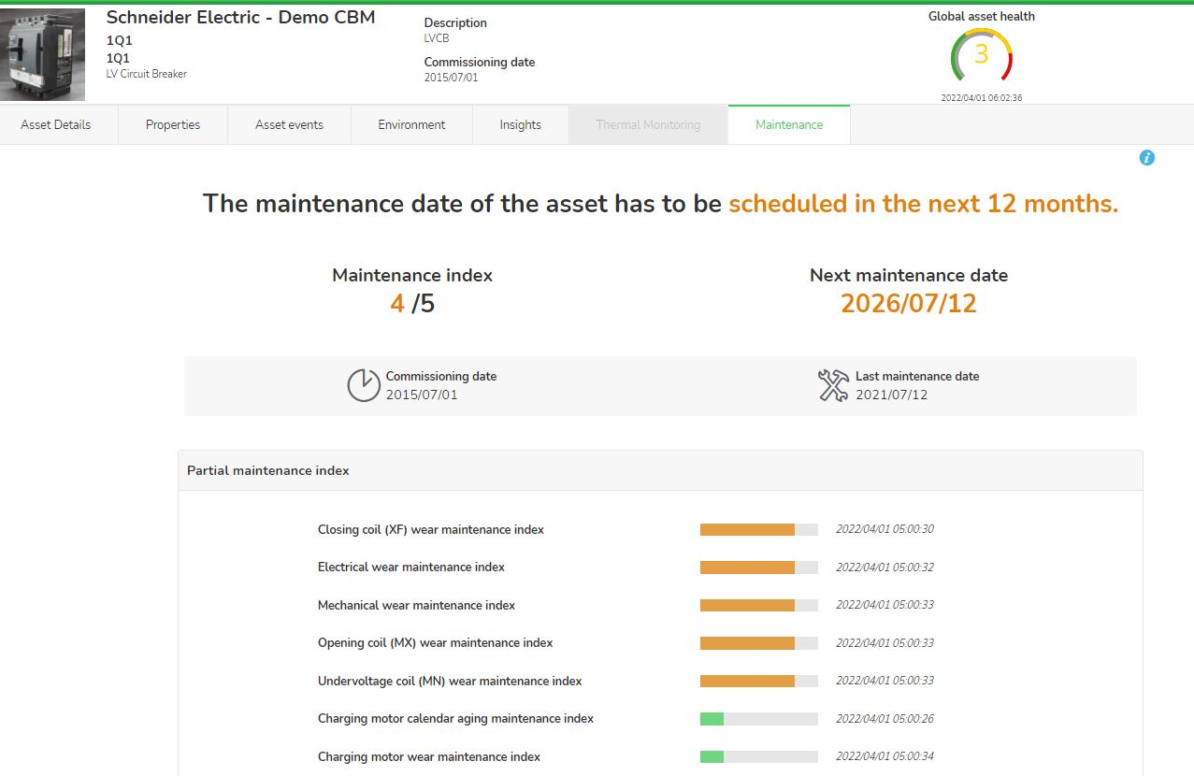
EcoStruxure Asset Advisor – Analytics overview
Asset Health index
Fire Prevention index
Maintenance index
To follow-up the health status of your assets
Based on field data and advanced analytics
24/7 monitoring accessible to you via Mobile App & Web portal
You receive Alarm Notifications
In case of abnormal situation, a Connected Services Hub expert contacts you by phone
One health index for each connected asset + one overall site Health index considering assets criticality and health status
To mitigate the electrical fire risk in your installation
Based on field data and advanced analytics
24/7 analysis of potential source of fire and localization in the equipment
You receive Alarm Notifications
In case of imminent risk, a Connected Services Hub agent contacts you by phone
Access to data via Mobile App & Web portal
To move from calendar to condition-based maintenance:
Assets connected to our Cloud platform benefit from maintenance cycle extension up to 5 years
You can see your maintenance schedule in a dashboard and receive Alarm Notifications
For each asset, a Maintenance Index indicates if maintenance has to be preponed vs initial date to avoid potential failure and/or premature ageing
A Connected Services Hub expert contacts you to propose re-schedule the maintenance earlier
Our Field Service Engineer intervenes with more efficiency and insights thanks to our analytics

Slide 17
The Success Stoiries

Slide 18
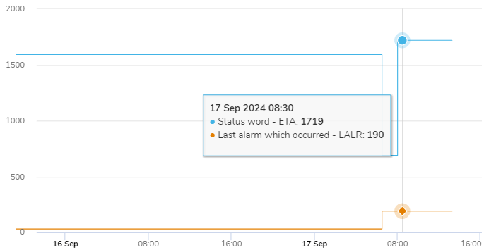
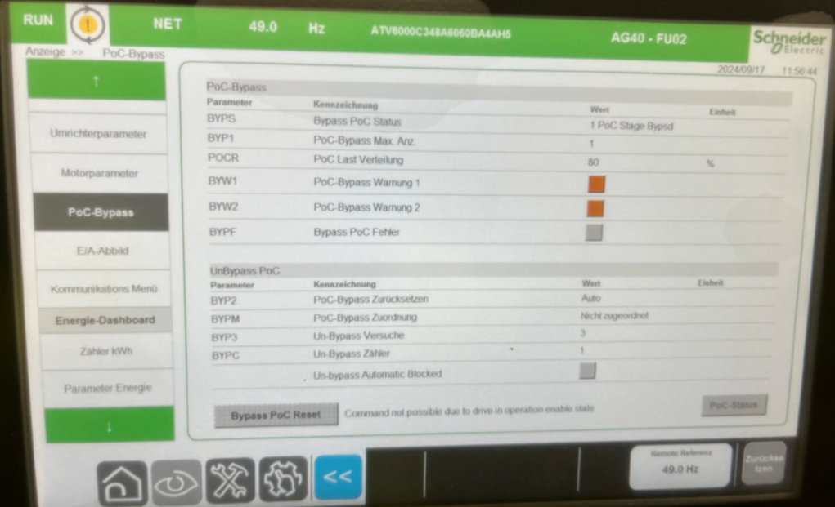

MMM Steel production facility in Europe, VIP customer
ATV6000 MV drive warning detected by EAA
MMM
EAA detected event raised on MV Drive ATV6000, ALR code 190, indicating Power Cell (PoC) bypass. Customer was contacted instantly with steps to investigate PoC bypass warning. Customer acknowledged the PoC bypass.
Event
Cause
Event triggered by PoC bypass per three phases on MV Drive ATV6000 output.
During further remote analysis, decision was made to dispatch Field Service to investigate the root cause of the event and remedy.
Recommendation
Key success factor:
EAA detected event and CSH informed Customer, which acknowledged the warning; CSH successfully supported coordination with SE drive experts and Field Service
EAA detected alarm event on MV drive ATV6000 and Customer was instantly informed with troubleshooting instructions and field service dispatched to prevent potential process stop.

Slide 19
Biomass Power Plant
Replacement of fans on ATV 630/650 Drives
Biomass plant
Event
EAA detected operating hours threshold for floor standing drives ATV650 has been reached and created event. Further analysis showed that fans operating hours has been reached and replacement of the drive fans should be done.
Cause
Operating drive requests proper cooling for power electronics and cabinet, hence cooling fans operating hours are increasing.
Key success factor:
EAA ED continuous monitoring of drives including fans operating hours and indication that operating hours has been reached
Recommendation
Customer was advised to take steps towards drives inspection procedures and replacement of drives fans to secure proper cooling and reliability of the drives.
Customer was informed about operating hours of power and cabinet fans and advised to make replacement. Replacement is necessary for securing proper drives cooling and avoiding potential overheating and negative impact on facility production and costly downtime.

Slide 20

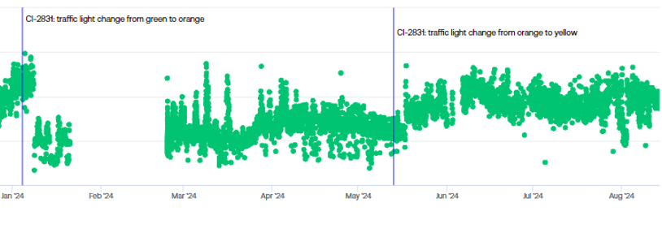

SA Cement Plant
Segment
Chain conveyer mechanical unbalance
Event managed by Denis Ilić, EMEA Hub, Mohamed Sayed Abdel Khalek Afifi, SME for Industry, Bogdan George Paraschiv, Digital Service Sales Romania
On the January 2024. mechanical unbalance indicators are detected on application side. Customer is directed to ispect motor shaft and bearings, shaft on the application side. Inspection of the asset ends without findings.
Event
Monitoring continues with strong accent on a need to perform a detail investigation on this event as detected issue is still present. At the end of July output shaft is found broken. After replacing the shaft condition returns to good!
Cause
Spectral energy of the monitored asset
Customer was assured that monitoring solution did a good job detecting issue 6 months in advance. Even though shaft fatique is a challenge to be found by visual inspection, customer was assured that if next time monitoring solution indicates an issue detail investigation is needed, as monitoiring solution has been proofing its reliability.
Recommendation
Customer focus and trust. Emphasizing possibilities of the monitoiring solution.
After several good findings customer chooses to continue colaboration and renewed contract for 3 years.

Slide 21
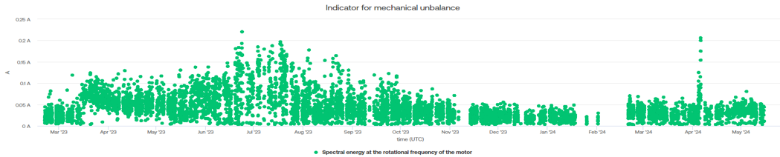
SA Cement Plant
Segment
Hummer crusher mechanical unbalance
Event
On the March 2023. mechanical unbalance indicators are detected followed with small escalation during the summer months of 2023. Customer is directed to ispect motor bearings, coupling and application side as a possible causes detected. Inspection of the asset ends without findings.
Monitoring continues with strong accent on a need to perform a detail investigation on this event as detected issue is still present, On maintenance done in the begining of 2024. hummers of the crusher are found as needed for replacement, after condition of the drivetrain returned to good!
Cause
Spectral energy of the monitored asset
Customer was assured that monitoring solution did a good job detecting issue well in advance. It helped in preventing further degradation and possible damage to the shooter and crusher itself. Also, customer maintenance plan could be upgraded with more focus on a hummers in the future.
Recommendation
Customer focus and trust. Prevention possibilities of the monitoiring solution.
After several good findings customer chooses to continue colaboration and renewed contract for 3 years.

Slide 22
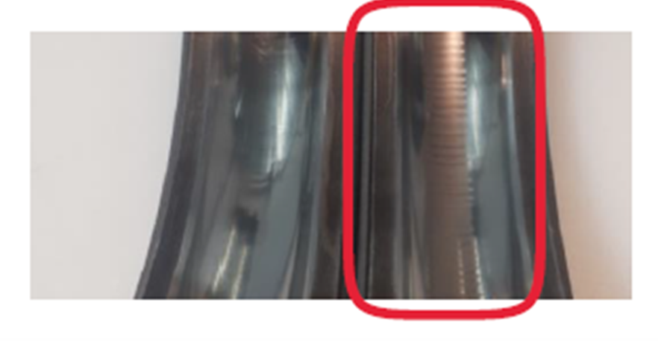
Food and beverage production facility
Signs of Bearing Fluting
Food and
beverage
Customer acquired EAA MCSA (Motor Current Signature Analysis) solution to monitor three AC motors 75kW, 200kW and 500kW operating in food and beverage production facility in Europe. Customer was experiencing issues related to 200kW motor bearings in terms of bearing fluting damage.
Event
Cause
PWM (Pulse Wave Modulated) generated sine waves, produced by VFD’s, can cause voltage potential in the motor structure, leading to voltage passing between the rotor and stator to ground through the motor bearings causing damage.
Recommendation
Customer was advised to take steps towards considering installing SGR (Shaft Grounding Ring) to avoid earthing the motor shaft through motor bearings.
Key success factor:
EAA ED continuous monitoring and advance analysing of motor parameters through MCSA resulted in proposed solution to customer
Customer informed that bearings are changed very often and bearing signs of degradation starts with loud noises, followed by increasing vibration. By analysing MCSA waveforms and close collaboration with customer, proposed solution is to instal SGR, thus avoiding frequent bearing changes and costly downtimes.

Slide 23
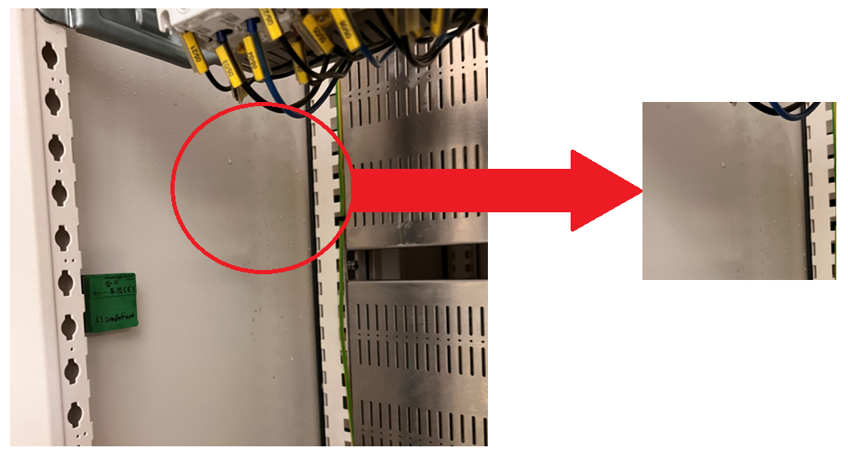
Pictures of detected issue

Slide 24

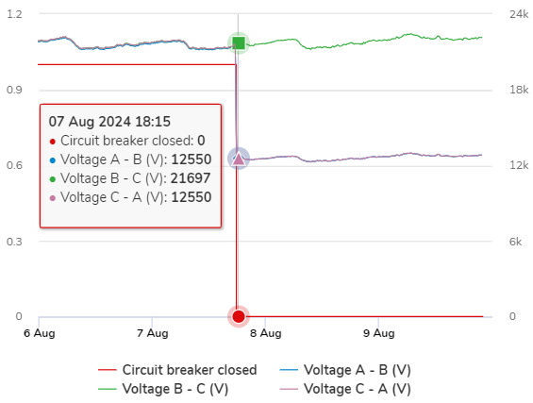
Egypt
Loss of one phase voltage measurement on MV Circuit Breaker
HEALTHCARE
Event
EAA detected opening of site second incomer MV Circuit Breaker. During event analyzing, it was detected that voltage phase A measurements are missing, and customer was informed.
Cause
Potential issue with VT or its wiring to protection relay.
Assessment of Customer’s MV Cubicle VT and its wiring. Customer maintenance team acknowledged the issue and scheduled the issue investigation as soon as process allows.
MV CB voltage measurement
Recommendation
Customer was timely informed about the issue on second incomer MV Circuit breaker to investigate the root cause, thus avoiding potential negative impact on facility production and costly downtime.
Key success factor:
EAA ED detected event on MV circuit breaker

Slide 25
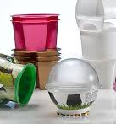
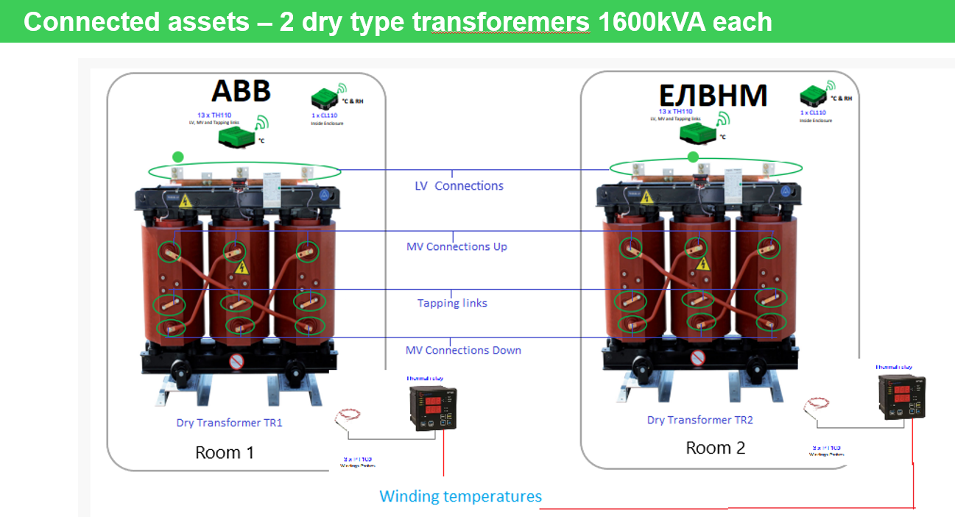
Greece
Segment
Load balancing
Event managed by Denis Ilić, EMEA Hub, Marios Michelopoulos, Service Sales Engineer SE Greece
Ambient, winding and connections temperatures are monitored on the site. Ambient conditions on one transformer were with temperatures near or even above 40°C, but winding temperatures were OK. On other transformer winding temperatures are reaching values near 120 °C even though ambient temperatures were lower.
Event
Based on these temperatures, it was concluded that second transformer is probably more loaded, and that probably load rebalance can be done, avoiding the risk that transformer trips during the hot summer days.
Cause
Only temperature is monitored, Dry transformers, ONAN.
It was recommended to check the load balance and search for possibility to better balance load between these two transformers. As they were of a different manufacturer and age, it was strongly adviced to check cooling ducts between windings for any clogs and dust that might prevent proper natural cooling. Customer checked and confirmed additional load on second transformer. Planned load rebalancing.
Recommendation
After load rebalancing conditions were improved, and risk for sudden outage is prevented. Customer gained significant trust in the proposed solution.
After great colaboration, customer was satisfied with solution. Planned to include electrical parameters and add more transformers in renewal.

Slide 26
Notes:
Closing slide

